Slide 1
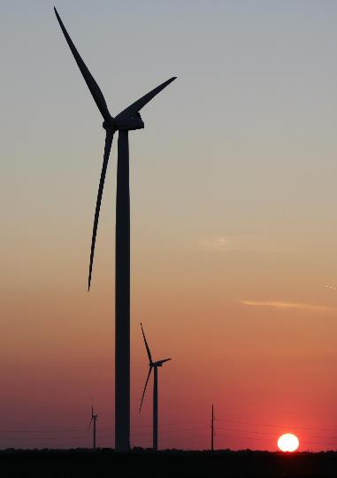
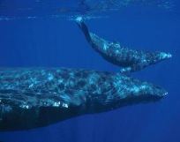
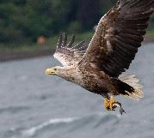
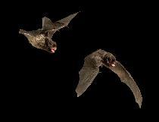

Environmental Co-Design
Photo by NOAA/NMFS
Photo by iStock
Photo by C. Hein, NREL
Cris Hein, National Renewable Energy Laboratory
Grand Challenges in Wind Renewable Energy: from technology and sustainability to social acceptance and economics
4 December 2024
Photo by C. Hein, NREL

Slide 2
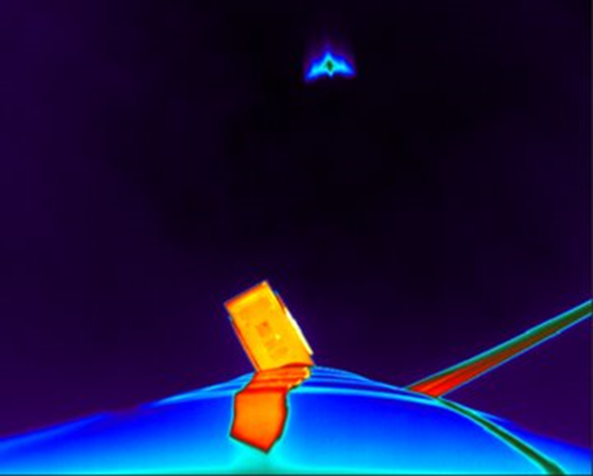

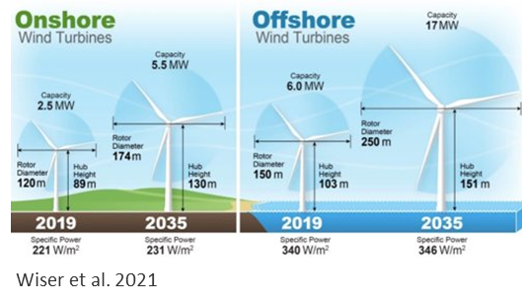
Environmental Challenges associated with Wind Energy
Ecology
  Population size & trends
  Activity & migratory patterns
Impacts
  Influence on environmental processes
  Collision/avoidance/entanglement
Technology
  Integrating technologies with wind turbines
  Adapting to changes in wind turbines
Costs
  Monitoring & research
  Permitting & mitigation

Slide 3
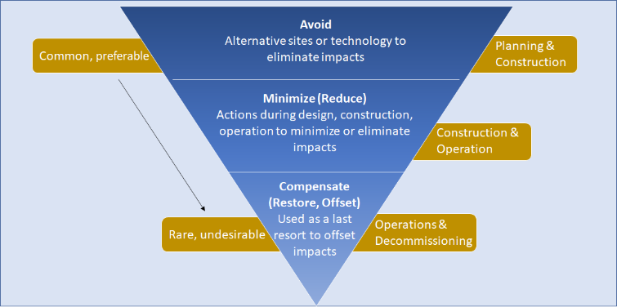
Mitigation Hierarchy
Lessen negative impacts of an action leading to no net loss

Slide 4
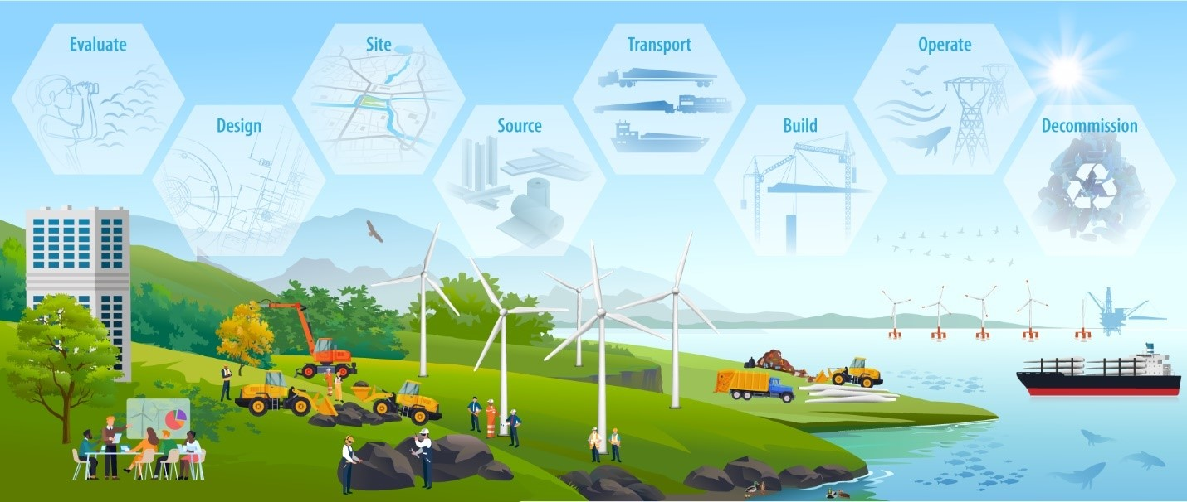
1. Critical Issue: Avoiding, Minimizing, and Compensating for the Direct and Indirect Environmental Impacts
Opportunities for mitigating environmental impacts occur at each stage of the wind turbine and wind plant lifecycle

Slide 5
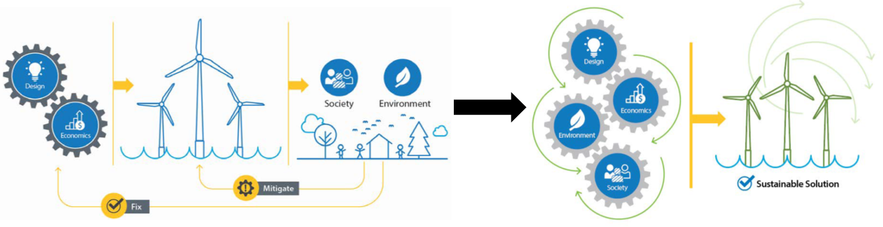
2. Critical Issue: Incorporating Environmental Costs and Benefits into Every Decision Point
Transition from the current approach (Left) where social & environmental aspects are considered after the fact, to a co-design approach (Right).
Image by Carlo Bottasso, Technical University of Munich.

Slide 6

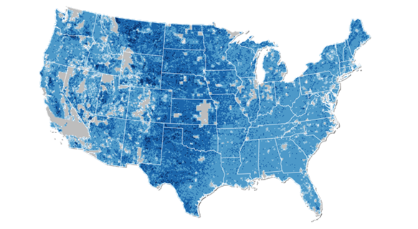
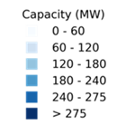

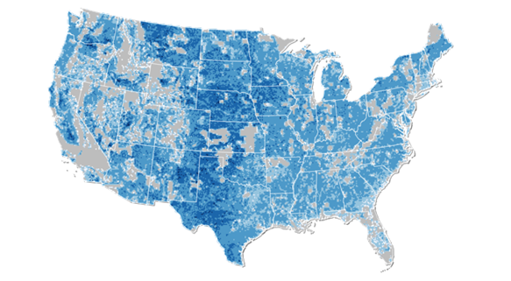
3. Critical Issue: Accounting for Immediate Concerns While Addressing Future Impacts and Tradeoffs
Awareness of relevant spatial and temporal scales
Define tradeoffs
Model build-out and transmission based on different scenarios
Balance climate consequences with environmental impacts from wind & other renewables

Slide 7
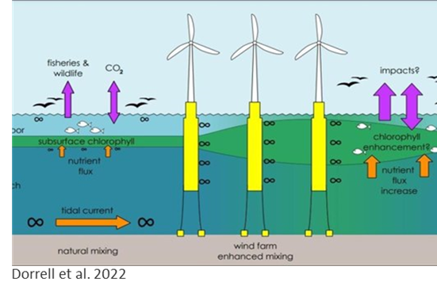
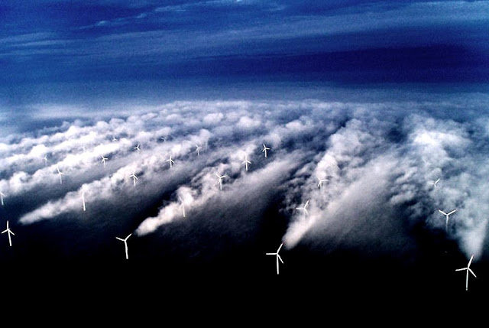
Research Opportunities:
Atmosphere & Environment
Atmospheric conditions &
  Wildlife use/movement patterns
  Ocean surface/subsurface conditions (e.g., turbidity, food webs)
Wake effects on local vegetation & microclimate (e.g., aridification)
Photo by Christian Steiness, Vattenfall

Slide 8
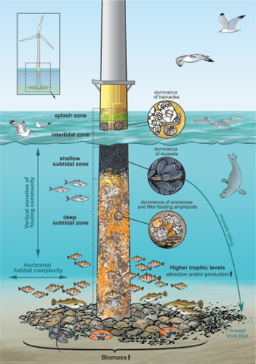
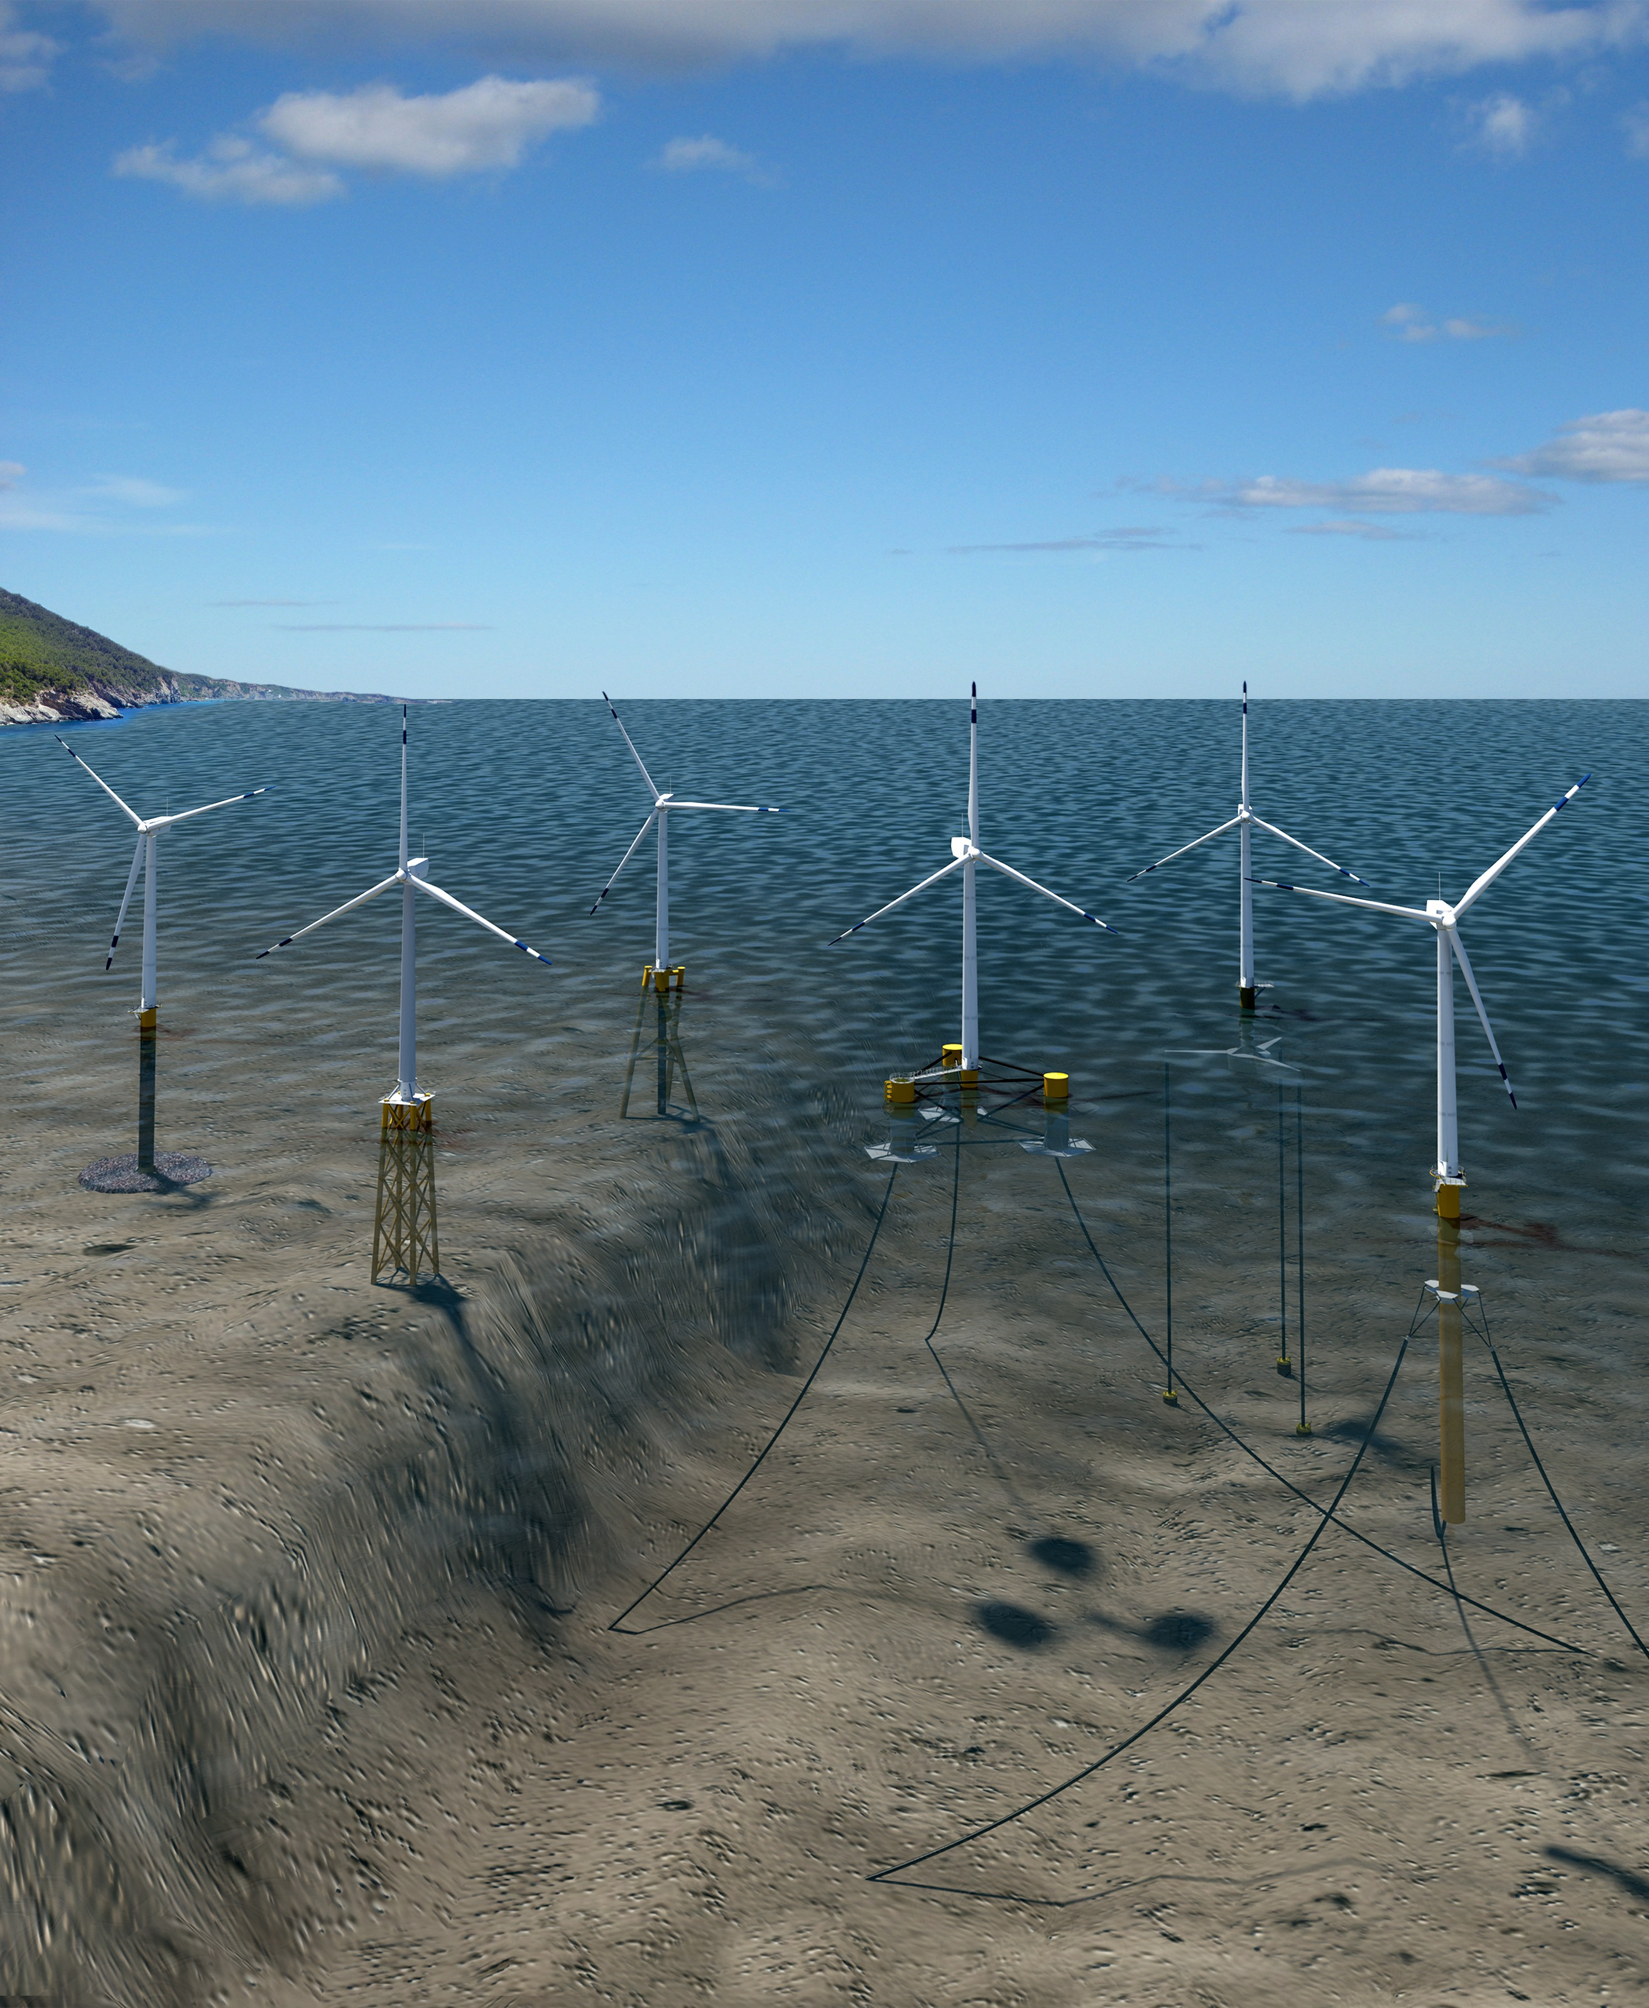
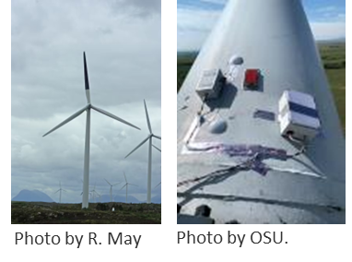
Wind Turbine Design
Research Opportunities:
Turbine & Environment
Foundation type (Fixed or Floating)
  Turbines & subsurface flow
Specifications of wind turbines
  Height, blade length, cut-in speed
Lifecycle analyses
  Material components
  Recycling v. landfills
Integrating monitoring & minimization technologies
  Safety, cybersecurity, installation, warranties
  Importance of blades for technology
Image by Hendrik Gheerardyn
Image by J. Bauer, NREL

Slide 9
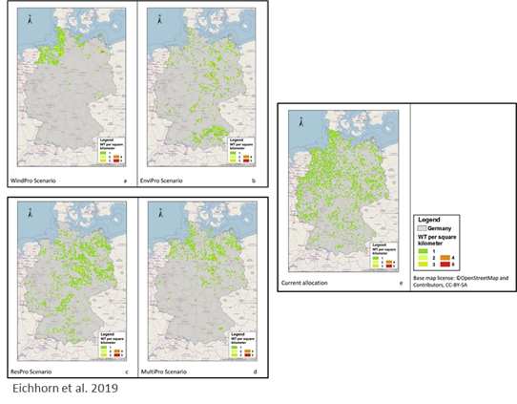
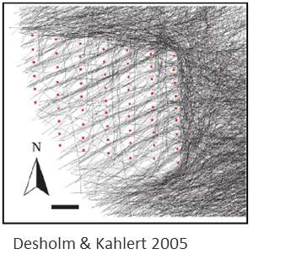
Plant & Grid Design
Research Opportunities:
Plant-Grid & Environment
Development scenarios (fewer/larger v. many/smaller wind farms)
# of turbines & layout on animal use & movement patterns
Impact of curtailment on Power Production & the Grid

Slide 10

Transdisciplinary Research
Multidisciplinary: Disciplines working with little to no collaboration
  Solutions developed for one discipline may not be feasible for another
Interdisciplinary: Disciplines integrated at some level
  Solutions developed by one team used to guide others
Transdisciplinary: Disciplines work together as a single team
  Solutions developed through seamless integration
G. T. Aguinaldo, Envilearn, LLC

Slide 11
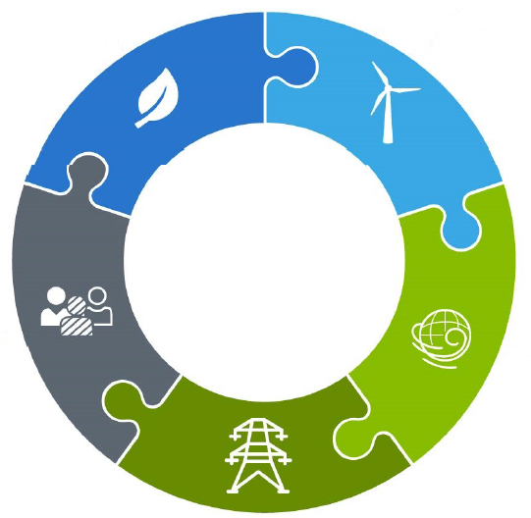
Transdisciplinary Approach to Curtailing Wind Turbines for Bats
Quantify bat interactions with wind turbines
Build sophisticated control systems to account for several variables
Socialize with investors, power purchasers, & consumers
Relate bat interactions to atmospheric conditions
Quantify changes in power production & impact to the grid

Slide 12
Initiatives Needed to Address the Critical Issues
Network of wind farms for transdisciplinary research. Establish a strategic network of research-driven commercial-scale projects to conduct transdisciplinary studies and validate monitoring and minimization technologies across all phases of development
Cost and benefit metrics. Adapt existing frameworks to identify and convey metrics for environmental costs and benefits for project developers
Standardized practices. Develop an ISO-like standardization (or recommended practices) for data collection, analysis, and reporting to facilitate comparability across projects

Slide 13
Initiatives Needed to Address the Critical Issues cont.
Data sharing framework. Develop a publicly available data framework that is transparent, standardized, and objective-based, for multi-scale decision making
Transdisciplinary data. Identify and aggregate data and metrics from other research areas (atmosphere, turbine, plant/grid, economic, social) to facilitate environmental co-design
Mitigation system. Design a mitigation system for all stages of wind farm development (i.e., evaluation through decommissioning), incorporating measures for avoidance, minimization, and compensation, that are additional, achievable, and verifiable

Slide 14
Further Research and Actions
Engage with participants at non-environmental conferences and promote multidisciplinary panels/sessions at environmental conferences
Establish multidisciplinary working groups with other research fields to define research gaps and recommendations for follow-on work
Conduct a horizon scan of the potential environmental impacts of future deployment scenarios to help with long-term decision making
Establish a common language of terminology to facilitate interdisciplinary discussions

Slide 15
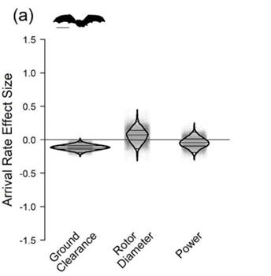
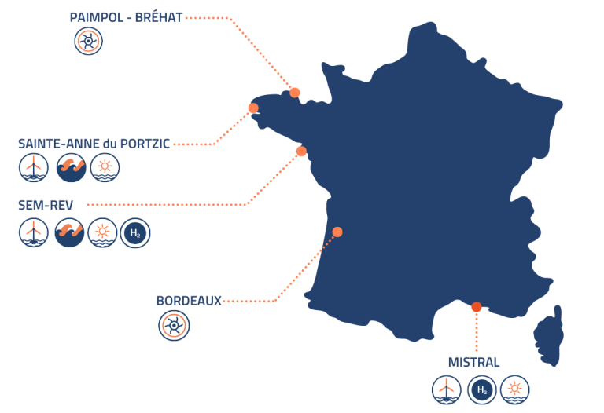
Wind Turbine Design
Opportunities for Cross-disciplinary Research
Turbine size & bat fatalities (Garvin et al. 2024)
  Shorter ground clearance increased bat fatality
PELAgIO (www.ecowind.uk/projects/pelagio/)
  Physics-to-Ecosystem Level Assessment of Impacts of Offshore Windfarms
  Effects of wind energy extraction on the water column (e.g., nutrient density, oxygen, etc.)
OPEN-C Foundation Test Facility, France
  Europe’s largest offshore testing facility
  Grid innovation, technology validation, environmental monitoring

Slide 16

Wind Turbine Design
WREN Activities to Address the Grand Challenges
WP2: Collaborations with IEA Wind Tasks
  Host other Tasks at WREN meetings / represent WREN at other Task meetings
    Wind energy digitization, blade recycling, wind energy economics, integrated design of floating wind arrays, wind farm controls & social sciences
  Produce outreach materials on research priorities
  Develop & implement cross-cutting research
WP3: Engagement & Outreach on State of the Science
  Focus on Environmental Co-design Critical Issues
  Address broader spatiotemporal scales (e.g., life cycle analysis, cumulative effects)

Slide 17
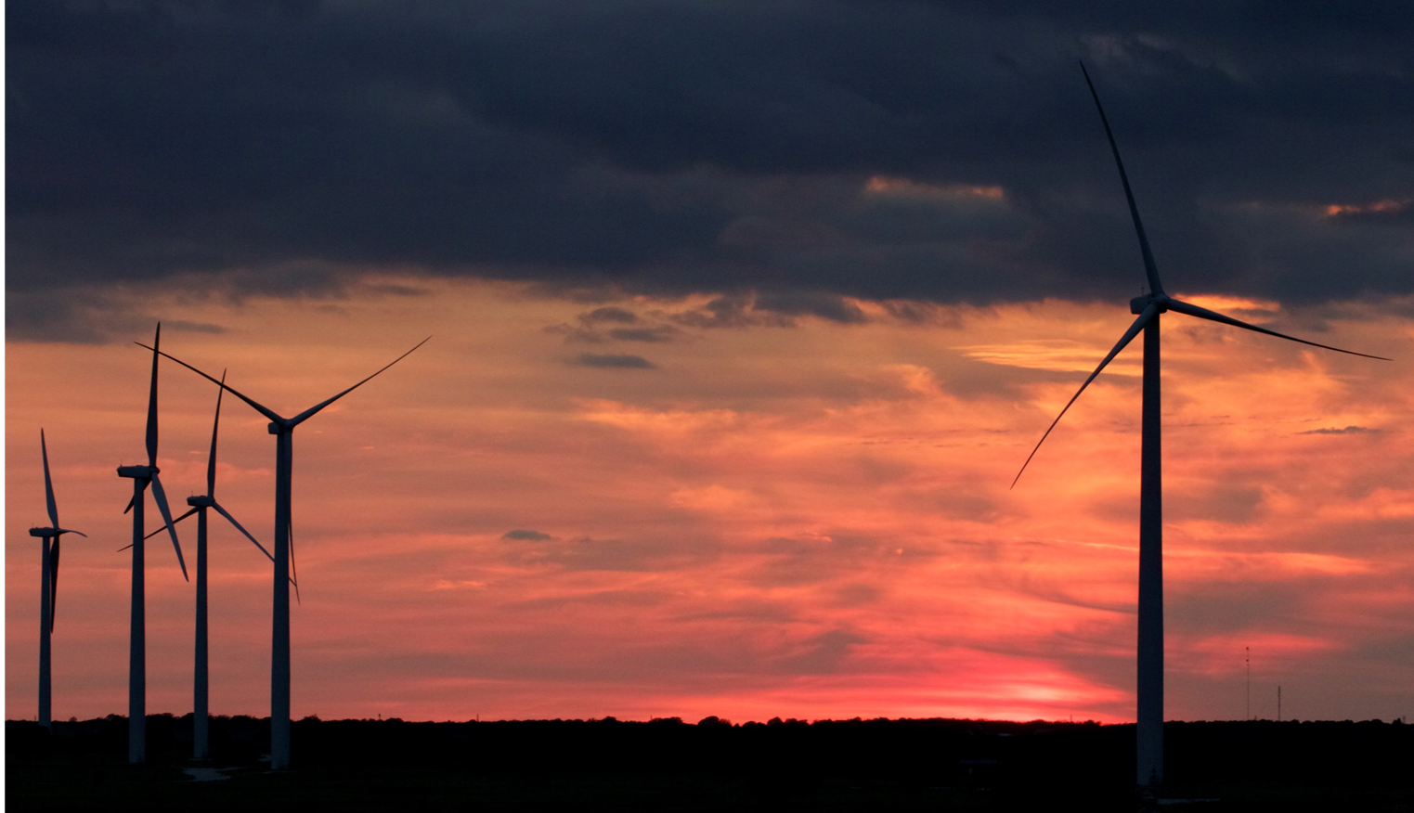
Thank You
Cris Hein, cris.hein@nrel.gov

