Slide 1
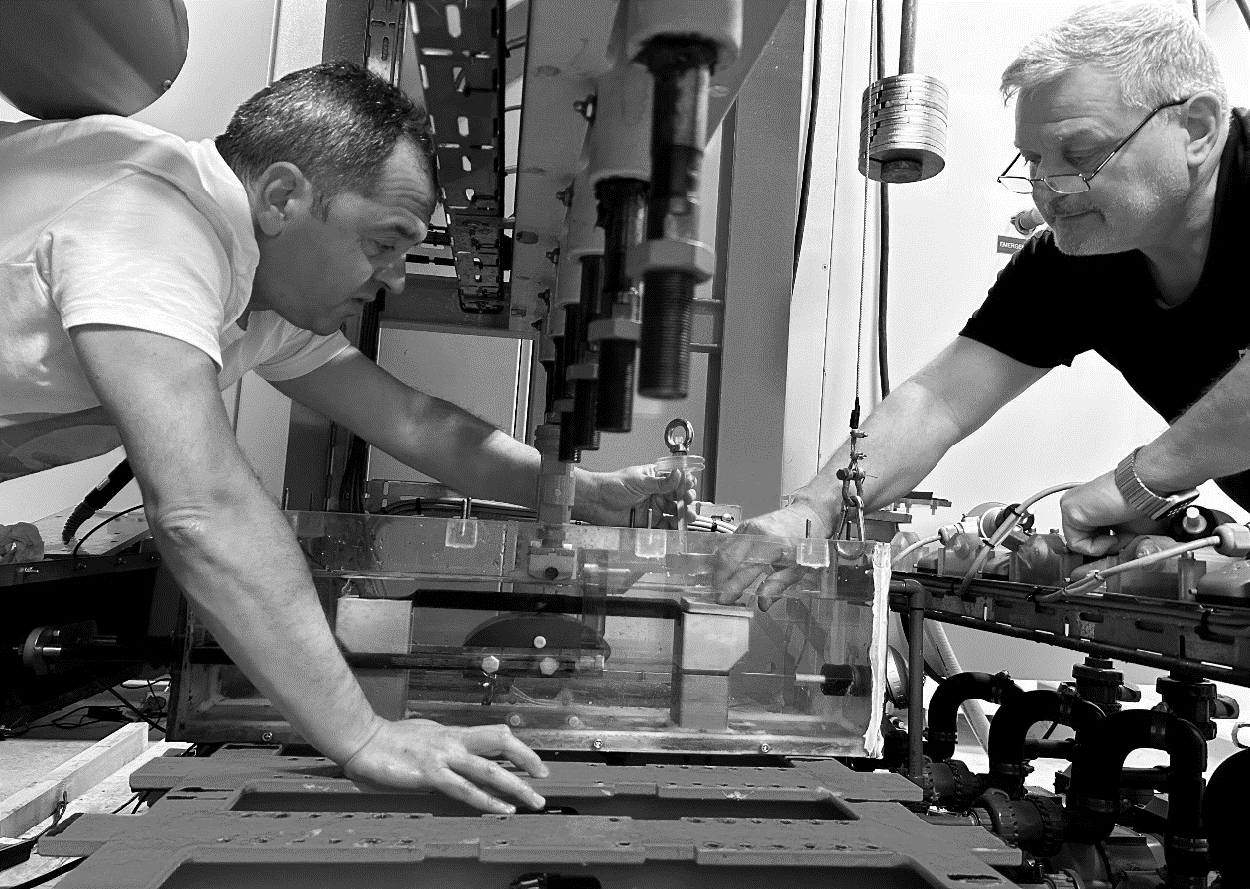
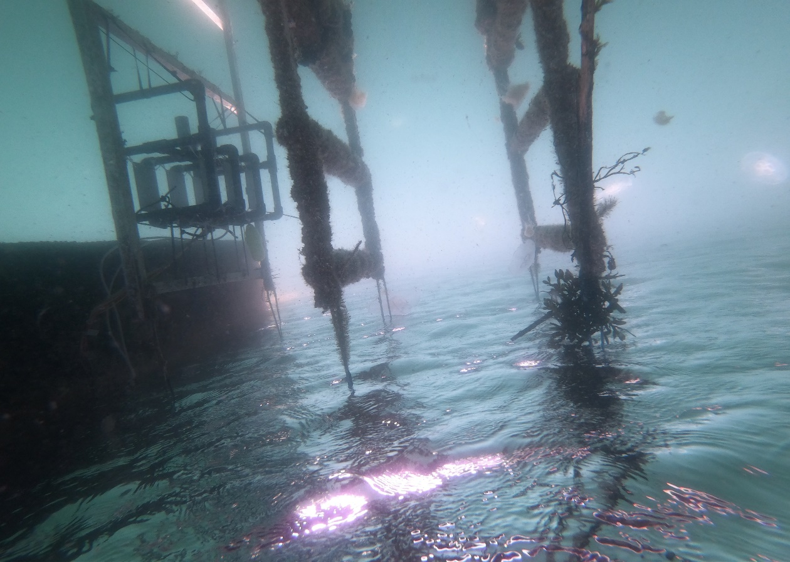
MORE
Next Generation Marine Materials for Resilient Offshore Renewable Energy Devices
Johan Lindén, RISE Research Institutes of Sweden

Slide 2
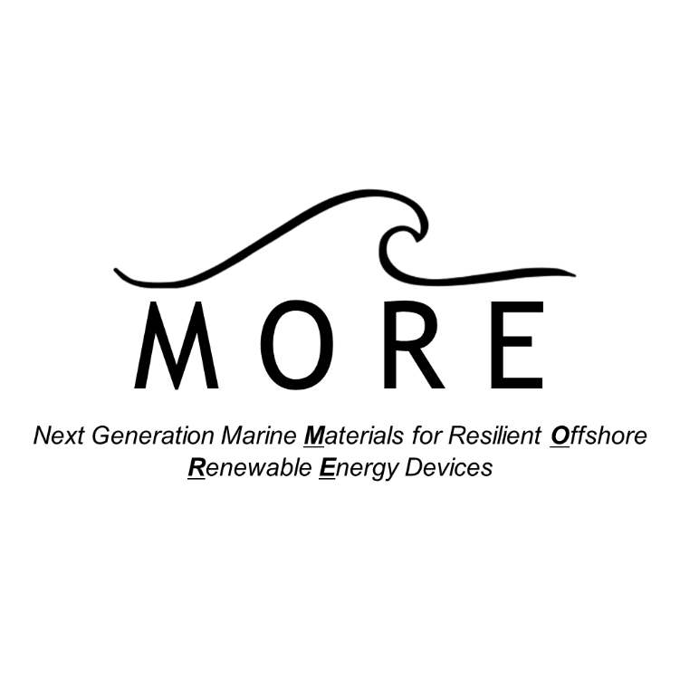
Challenges – specific needs
Material Degradation in Harsh Environments
Offshore devices are constantly exposed to wear, corrosion, and fatigue, particularly in wave energy converters. Current materials struggle with these combined stress factors, leading to high maintenance cost and short lifespans.
Lack of Standardized Testing for Multi-Degradation
Existing material testing guidelines don’t consider multi-degradation effects like combined tribo-corrosion and fatigue. This results in unreliable predictions for material durability equipment lifecycle.

Slide 3
Solution
Improved Material Testing & Validation
We will develop accurate, accelerated testing methods that account for complex, multi-degradation processes in marine environments.
Standardized Guidelines for Material Selection
We will create clear, reliable guidelines will help the industry choose materials that withstand offshore conditions, lowering costs and increasing lifespan.

Slide 4









Our consortium
Supply Chain
Technology Developers
Validation & Impact
Market Implementation
Research & Innovation

Slide 5
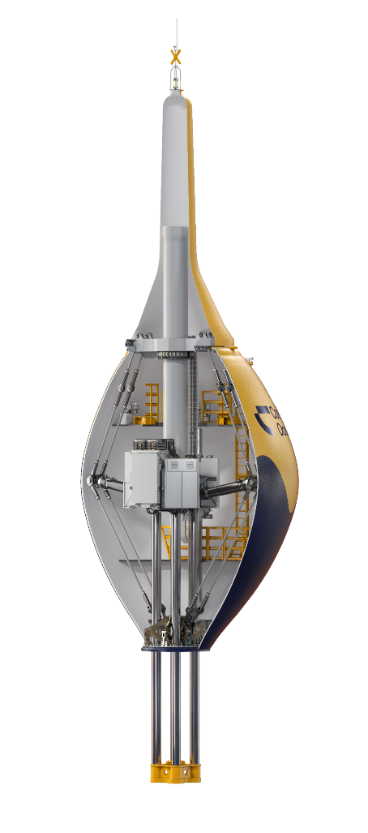

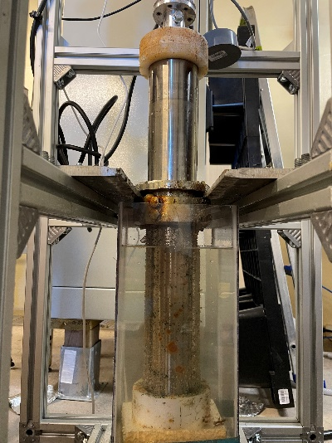
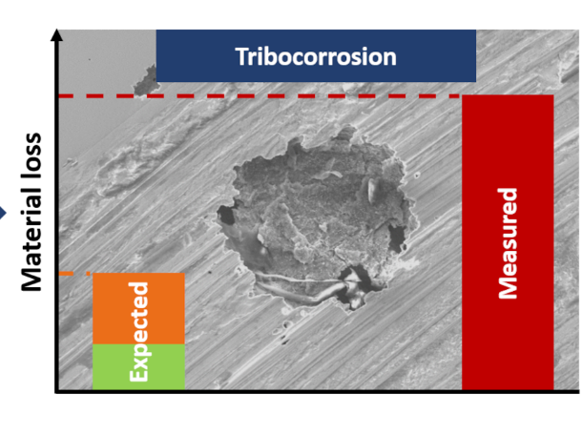
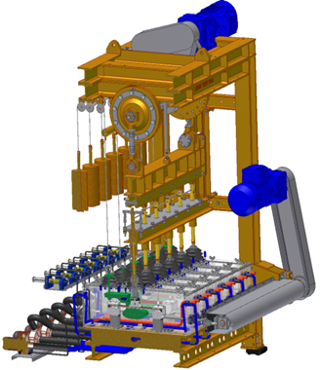
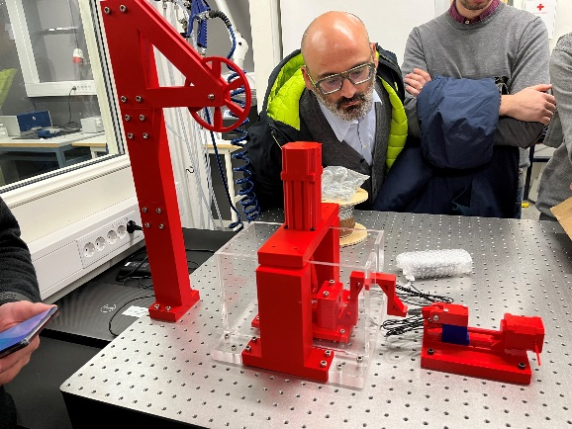
Methodology
Offshore Renewable Energy Sector Needs
M O R E
Fundamental Research
Small Scale
Multi-degradation Testing
Accelerated Tests
Lab Scale
Multi-degradation Testing

Slide 6
With MORE’s approach, the offshore renewable energy sector will achieve a lower Levelized Cost of Energy (LCOE), reduce environmental impact, and enhance European leadership in the transition to sustainable energy sources. The project will set new industry standards, providing a blueprint for resilient, cost-effective ORE technology.
Towards Resilient Offshore Renewable Energy

Slide 7
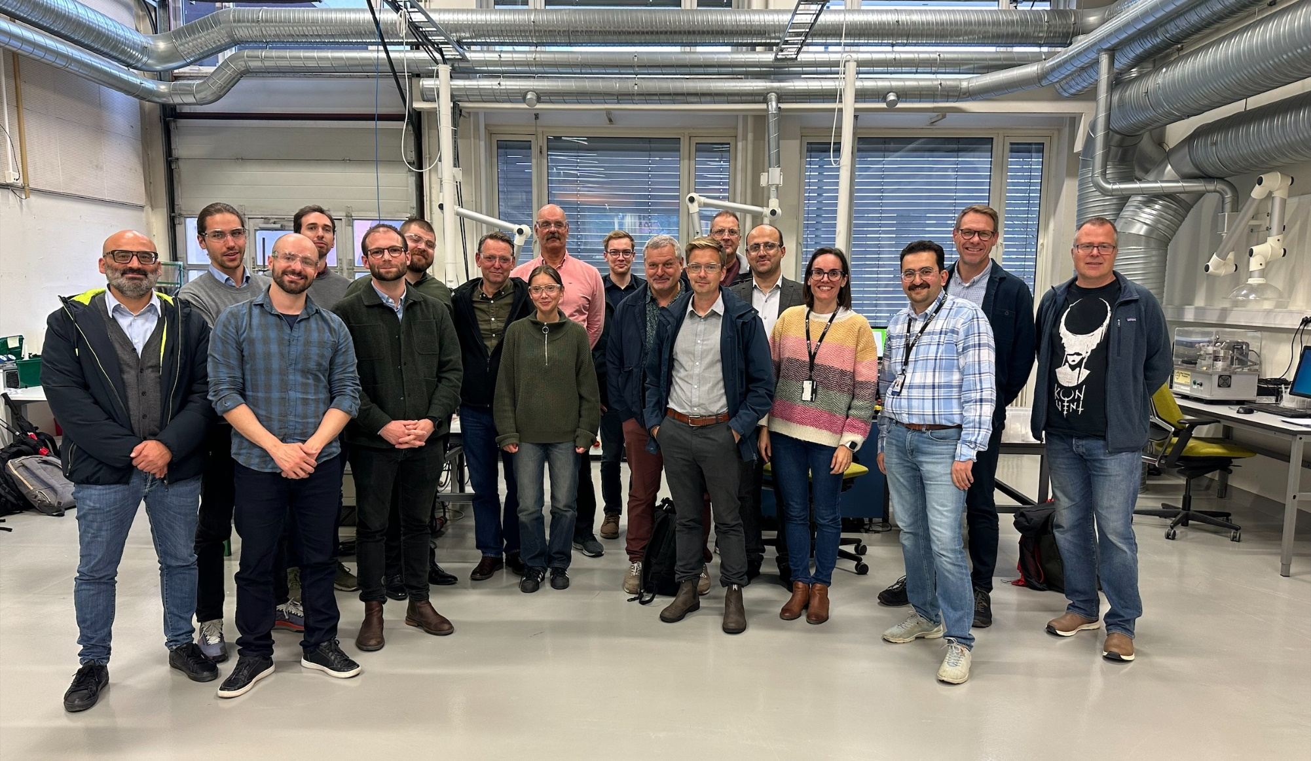





Contact us!
Johan Lindén, Project coordinator and Researcher at RISE
E-mail to johan.b.linden@ri.se
+46 76 864 00 66
www.more-cetp.com
www.linkedin.com/company/more-cetp
www.youtube.com/@MORE-CETP

