Slide 1
Clean Energy Transition Partnership Call Module 7: Integrated Regional Energy Systems
Presenter: Tina Ringenson, TRI5 and Swedish Energy Agency (SWEA)
Joined by: Angela Berger, TRI5 and The Österreichische Forschungsförderungsgesellschaft (FFG)
2025-09-16

Slide 2
Guidelines and rules
Please mute your microphone when not speaking
The Q&A session will be recorded to support documentation and improve our future work
Online data declaration: Please be aware that your name will be displayed in the list of participants as well as in the chat window
Questions will be answered at the end

Slide 3
Agenda
Key points of CM2025-07 Integrated Regional Energy Systems
Important facts and dates
Explanation of the Knowledge Community
Questions and Answers
Last minute matchmaking

Slide 4
Call Module 2025-07:
Integrated Regional Energy Systems

Slide 5
CM2025-07: Integrated Regional Energy Systems
The aim of the call module is to promote innovations in regional energy systems that significantly accelerate Europe's energy transitions.
It focuses on enhancing the functionality of the regional energy systems by improving the interactions between energy system components and different actors, including residents, businesses, the public sector, and the transportation system.
Notes:
The main message we want to convey in this presentation: Project should be focused on tackling a challenge on the regional level for the energy transition. In collaboration with regions from other countries of a similar type, what are the challenges you have in common and how can you solve them? We have some examples here, but you know better. One way to identify such challenges can be to look for them in existing regional plans and roadmaps for energy transition. We hope to see projects that can make model system solutions that can be transferred to other regions, and we are especially interested in projects in regions and sectors with high potential for improvement.

Slide 6
CM2025-07: Integrated Regional Energy Systems Target topics
Integration of regional infrastructures: Emphasise the roles of municipalities, local communities, industries, and stakeholders in shaping infrastructures and consumer dynamics.
Utilisation of local energy resources: Maximise synergies and flexibility in locally available renewable energy sources for heating, cooling, electricity, and transport.
Cross-sectoral integration: Promote collaboration across sectors, including transport, industry, and trade.
Research-driven innovation: Align research with initiatives like living labs for prototype development and testing
Notes:
Should include at least one of the following target topics

Slide 7
CM2025-07: Integrated Regional Energy Systems Project formulation
Project proposals should involve stakeholders of and reflect the needs of at least one specific region
Projects focusing on the challenges on the regional level for the energy transition, for example:
Increasing the regional share of renewables among all energy sectors
Optimising and integrating supplier and consumer infrastructure
Increasing flexibility and resilience within the regional energy system
Enabling citizens, need owners, and other stakeholders to take part in related regional value chains
→ In collaboration with similar regions from other countries, what are the challenges you have in common when it comes to the clean energy transition and how can you solve them?
Notes:
The main message we want to convey in this presentation: Project should be focused on tackling a challenge on the regional level for the energy transition. In collaboration with regions from other countries of a similar type, what are the challenges you have in common and how can you solve them? We have some examples here, but you know better. One way to identify such challenges can be to look for them in existing regional plans and roadmaps for energy transition. We hope to see projects that can make model system solutions that can be transferred to other regions, and we are especially interested in projects in regions and sectors with high potential for improvement.

Slide 8
CM2025-07: Integrated Regional Energy Systems Project formulation
Scalable, validated solutions to regional energy challenges on a system level
Proposals benefit from building on the results of, and linking to, ongoing or recently completed research and demonstration projects
Use of test infrastructure
Use of knowledge
Cooperation of key demos
Transfer on results
Project proposals should enable the consortium partners and/or relevant actors and stakeholders to organize, implement, and scale up solutions and results after the end of the project
Notes:
One way to identify such challenges can be to look for them in existing regional plans and roadmaps for energy transition.
We hope to see projects that can make model system solutions that can be transferred to other regions, and we are especially interested in projects in regions and sectors with high potential for improvement.

Slide 9
CM2025-07: Integrated Regional Energy Systems Requests
Proposals must take an integrated approach to the challenge. Technological development of only single components is ineligible.
Project budget: Funding requested from the Call in the range of (but not limited to) EUR 1.5–5 million, in addition to any self-financing
Target RDI approaches/TRLs: Should be TRL 6 or higher by the project's end

Slide 10
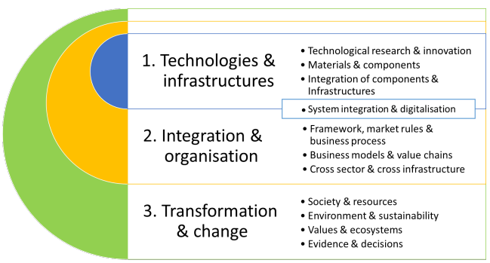
CM2025-07: Integrated Regional Energy Systems Dimensions of innovation (call text chapter 2.3.2)
For the description see Call Text chapter 2.3.2 Dimensions of innovation
Notes:
For integrated solutions, we expect that in the best case all layers (Technology & Infrastructure, Integration & Organisation and Transformation) are covered within the project. Proposals are expected to describe their impact in the dimensions addressed, which can also be complemented by a reference to European transition plans, such as the SET Plan83 and in particular the Implementation Working Group on energy systems 84 (IWG 4)
1. This dimension implies technologies and infrastructures, for conversion (including end use), storage and transport of clean energy and its carriers. The key question to address is: How can necessary new technologies and infrastructures be designed, developed, and implemented into effective technical solutions for clean energy? 2. This dimension implies integration and organisation of the technological solutions within energy systems, including institutional frameworks, to ensure continuous and flexible clean energy services and processes. The key question to address is: How can interactions and value exchanges between different sectors and stakeholders be organised to optimise the operation of energy systems? 3. This dimension implies system transformation and change, focussing on the transition processes and their preconditions with respect to interrelations between technology, society and environment. Aspects such as upscaling and replication, design of the human–technology interface, user behaviour, facilitation of innovation ecosystems as well as environmentally conscious design of products and services. The key question to address is: How can the change processes for the new energy system be shaped to seamlessly integrate into the daily lives and operations of citizens, businesses, communities, and infrastructure providers

Slide 11
Technological Readiness Levels as defined by the European Commission
TRL1 | Basic principles observed | Feasibility studies
TRL2 | Technology concept formulated
TRL3 | Experimental proof of concept
TRL4 | Technology validated in lab | Industrial research
TRL5 | Technology validated in relevant environment (industrially relevant environment in the case of key enabling technologies)
TRL6 | Technology demonstrated in relevant environment (industrially relevant environment in the case of key enabling technologies)
TRL7 | System prototype demonstration in operational environment | Experimental development
TRL8 | System complete and qualified
TRL9 | Actual system proven in operational environment (competitive manufacturing in the case of key enabling technologies; or in space)

Slide 12
CM2025-07: Integrated Regional Energy Systems Consortium and actors
Consortia of need owners in a shared geographical context with the intention of developing regional system level solutions.
Cover or involve local target groups
Involve distribution system operators and local or regional public authorities.
Specify which actors will implement the proposed solution.
If relevant actors are not part of the Project Consortium, explain how they will be involved in the project.
Notes:
We really hope to see public bodies involved in this project....

Slide 13
CM2025-07: Integrated Regional Energy Systems Consortium and actors
Consortia of need owners in a shared geographical context with the intention of developing regional system level solutions.
Private for-profit companies
Innovation clusters
Secondary and higher education establishments
Research organisations
Infrastructure providers and operators
Public bodies (municipalities, local and regional governments) etc.
Notes:
We really hope to see public bodies involved in this project....

Slide 14
Important facts and dates
Notes:
Tina

Slide 15
Funding agencies participating in CM2025-07
Not all funding agencies are involved in all call modules
Three or more participants per application
To be able to apply for this call module, at least two of the participants in the project consortium need to be based in a country with a funding agency that participates in this call module
Different funding agencies have different rules – please check yours!
Notes:
Tina

Slide 16
Countries with funding agents in CM2025-07
Austria
Belgium
Czech Republic
Denmark
Estonia
Finland
Germany
Hungary
Iceland
Ireland
Israel
Latvia
Lithuania
Malta
Netherlands
Poland
Romania
Slovak Republic
Spain
Sweden
Switzerland
Tunisia
Türkiye
United Kingdom
May be subject to change – Please stay updated on http://cetpartnership.eu
Notes:
Tina

Slide 17
Eligibility
Transnational eligibility criteria. Who and what is eligible for CETP funding overall? → Joint Call 2025 Documents | CETPartnership – Call text, Chapter 3
Call Module requirements. Who and what is eligible for the particular call module(s) you are interested in? → Joint Call 2025 Documents | CETPartnership – Call text, Chapter 7
National/regional requirements. Whom and what can your national funding agency support? → Funding Agencies and Call Modules | CETPartnership

Slide 18
What if…
… you want to collaborate with a partner in a country that does not have a funding agency participating in the call module?
They can participate as a self-funded partner.
… one partner is deemed ineligable by their funding agency?
→They cannot get funding from the funding agency, but can still participate as a self-funded partner.
Please make sure to thoroughly check each funding agency’s requirements!
If you have questions, please contact corresponding funding agencies!

Slide 19
Call Calendar
General information about the call
Stage 1 Opening for pre-proposal submission | 11 June 2025, 14:00 (CEST)
Stage 1 Closing for pre-proposal submission | 9 October 2025, 14:00 (CEST)
Stage 2 Opening for full-proposal submission | 9 January 2026, 14:00 (CET)
Stage 2 Closing for full-proposal submission | 12 March 2026, 14:00 (CET)
Funding decision communicated | Mid-June 2026
Project start | 1 September–15 December 2026
Application to national/regional funding agencies | Consult specific funding agency

Slide 20
The Knowledge Community (KnC) of the CETPartnership
Notes:
Tina

Slide 21
CETPartnership Knowledge Community The purpose
The Knowledge Community is an integral part of the CETPartnership and aims connect funded projects and other CETPartnership activities.
Leverage the knowledge produced in the framework of the funded projects and put it together to answer identified challenges and ultimately boost the clean energy transition.
Create a community of changes-makers that feel part of a CETPartnership and regularly contribute to the jointly generated knowledge.
Notes:
Tina

Slide 22
CETPartnership Knowledge Community The members and formats
Members
CETP project representatives
Other project representatives
Need-owners
Intermediates
Representatives of Funding Agencies
Formats
Working Groups and Taskforces
Thematic workshops and webinars
Joint publications (policy briefs, CETP briefs, …)
Peer-to-peer feedback sessions
Notes:
Tina

Slide 23
CETPartnership Knowledge Community The participation for funded projects
The proposals must include a work package called Reporting and Knowledge Community in their work plan, resource estimation: 15–25 days/year/project.
1. Reporting
Annual reporting
Final reporting
Abstract of main results
2. Contribution to formative evaluation
Giving feedback to other projects
Implementing feedback from CETP monitoring team and from other projects
3. Other contributions
Living documents
Working group meetings
Communication and dissemination
Notes:
Tina

Slide 24
Final advice and tips

Slide 25
To think about
Please take extra care with the ”implementation” part of your application – this is a common problem area
Please be aware that some countries have been frequently oversubscribed in CETPartnership
For partners for validation, please have a look at the CETP Impact Network https://research4impact.eu/cetp-impact-network/

Slide 26

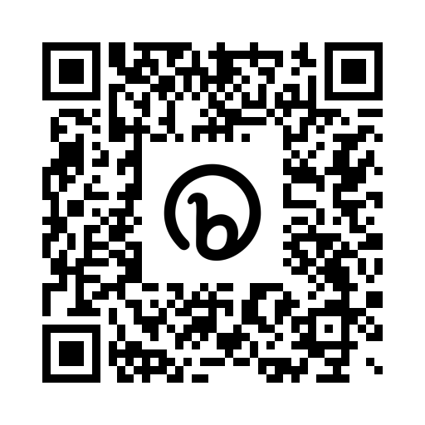

THE
JOIN
COMMUNITY
EVENTS
PROJECT MATCHMAKING
NEWSLETTER
bit.ly/CETPartnershipMatchmaking
EUROPEAN PARTNERSHIP

Slide 27
Questions?

Slide 28
Last Minute Matchmaking

