Slide 1
Balancing the grid: Flexibility for RES integration and support for Hydrogen and CCU
Expanding Horizons in the Hydrogen Economy
Dr Venizelos Efthymiou
efthymiou.venizelos@ucy.ac.cy

Slide 2
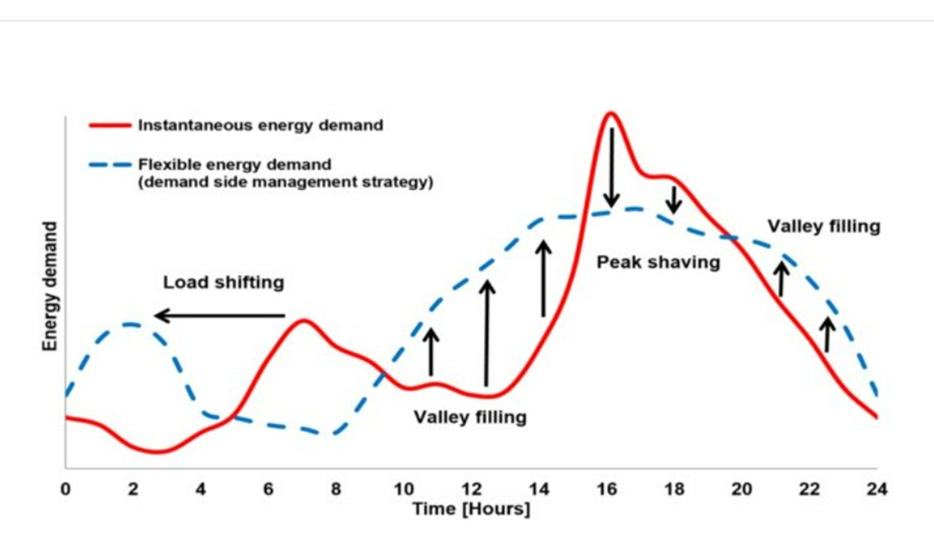
Flexibility in support of system needs

Slide 3
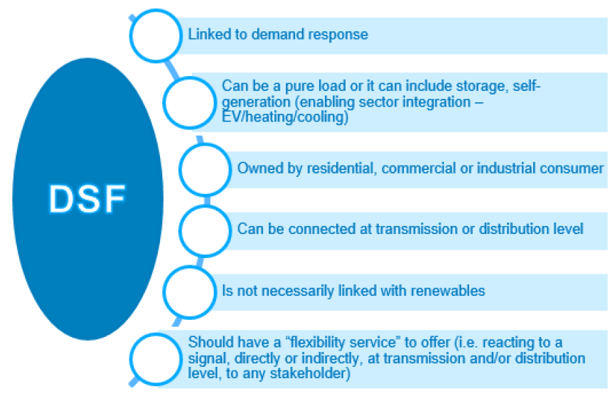
Demand Side Flexibility

Slide 4
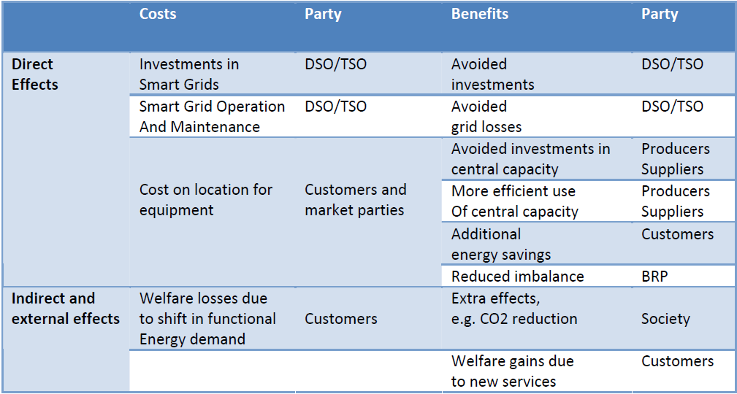
Summary of benefits and costs for stakeholders of flexibility

Slide 5


Slide 6
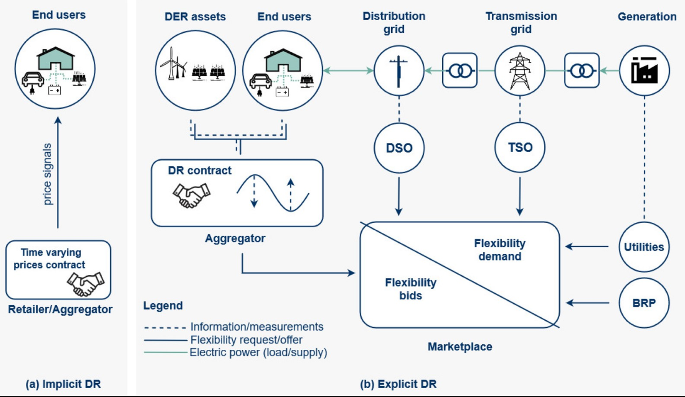
FLEXIBILITY serving implicitly or explicitly

Slide 7
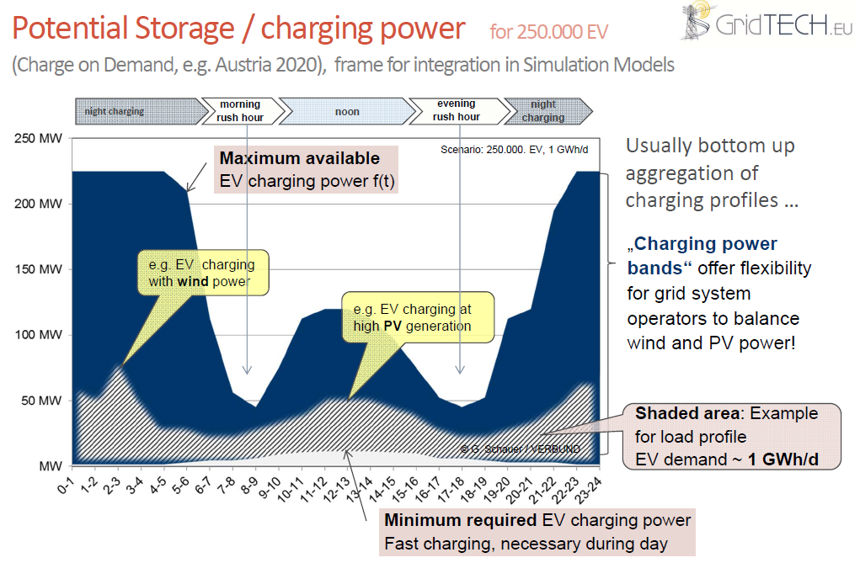

Slide 8
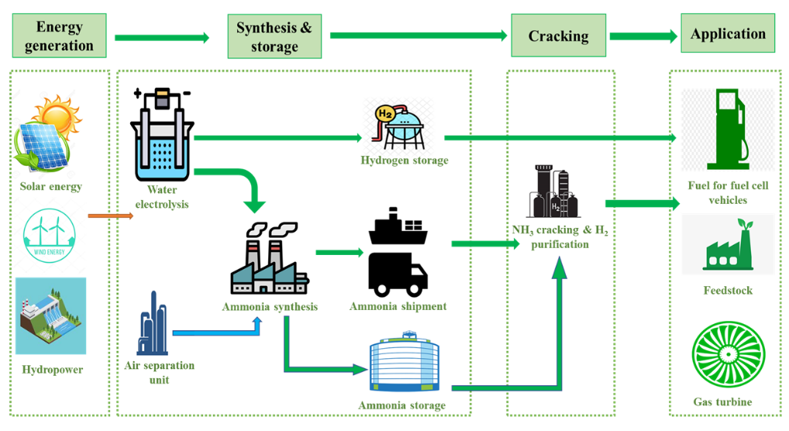
Flexible use of RES for green H2 production and use

Slide 9
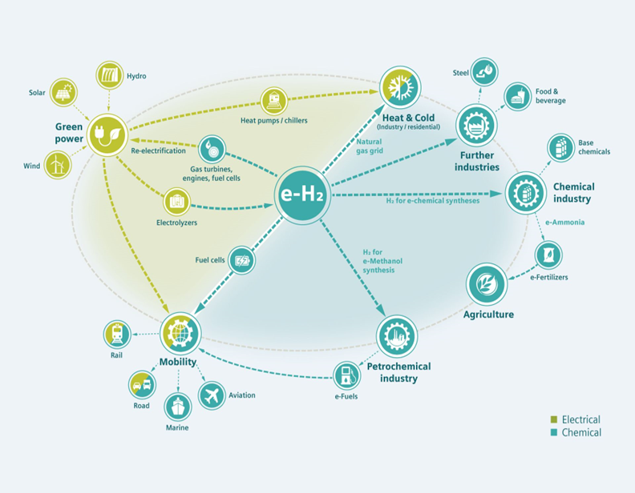
Flexibility in producing green H2 easily adapting to system needs as flexible demand!
Green hydrogen offers a sustainable and versatile solution for decarbonizing various sectors, including transportation and industry.

Slide 10

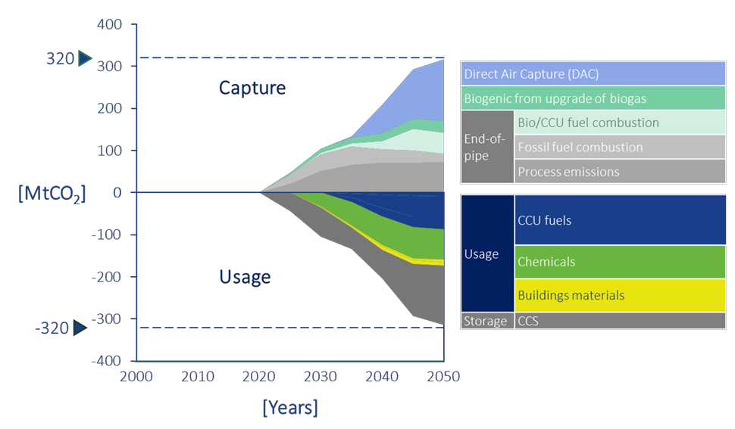
Carbon Capture, Usage and Storage applications based on the CO2 Value Europe expert vision scenario 2050

Slide 11
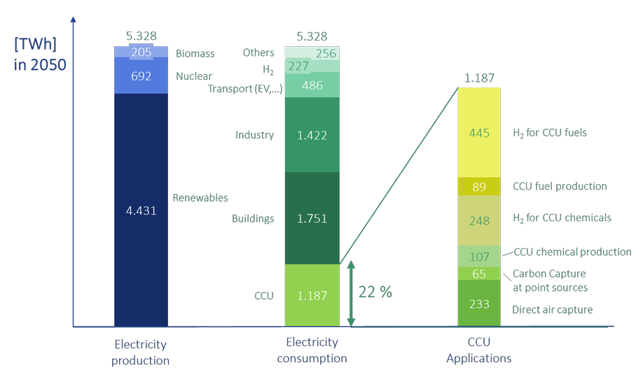

Electricity consumption of CCU related technologies compared to other sectors and electricity production mix in the EU

Slide 12
Thank you very much!
Questions?

