Slide 1
Cutting the cost for biogenic CO₂
– the principles and development status of Chemical-Looping Combustion (CLC) of biomass
Expanding Horizons in the Hydrogen Economy: Integrating Energy, Material Production, and CCU Value Chains - Insight Harvest
2024-10-16
Magnus Rydén
Chalmers University of Technology
Email: magnus.ryden@chalmers.se
Notes:
To add text in the slide master:
Go to the top menu, choose > View > Slide Master. In the absolute first slide, change to the preferred text.
Close Master View. The new text will permeate on all slides.

Slide 2
Content
The case for Chemical-Looping Combustion.
ACLOUD project pitch and activities.
CLC current status and future research needs.

Slide 3
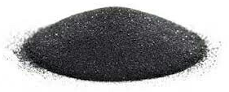
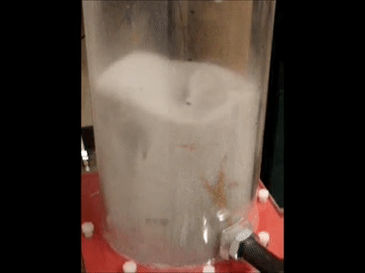
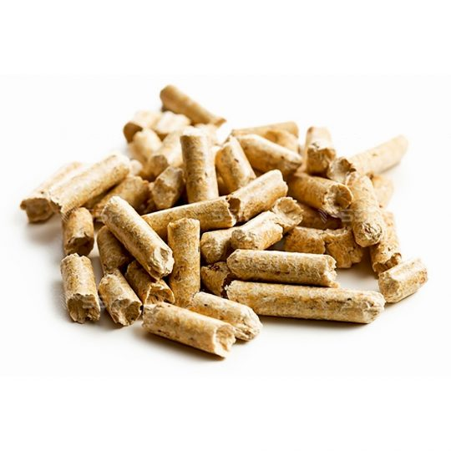
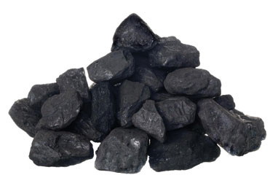
Chemical-Looping Combustion (CLC)
Nitrogen
N₂
Flue gas
CO₂, H₂O
OC-O(s)
Air Reactor
Fuel reactor
Heat
OC(s)
Air
O₂, N₂
Fuel
Example
Fuel = CH₄
OC-O = Fe₂O₃
OC = Fe₃O₄
Fuel reactor: CH₄ + 12Fe₂O₃(s) → CO₂ + 2 H₂O + 8Fe₃O₄(s)
Air reactor: 2 O₂ + 8 Fe₃O₄(s) → 12Fe₂O₃(s)
Total reaction: CH₄ + 2 O₂ → CO₂ + 2 H₂O

Slide 4
Basic reactor design
Depleted air
Sand-like particles of oxygen-carrier material (0.1-0.4 mm) as bed material.
High gas velocity (2-5 m/s) in the air reactor which acts as riser, particles are blown upwards and into a cyclone.
The particles are transported by gravity to the fuel reactor in which they are reduced by fuel, then continues to the air reactor.
Gas leakage between the reactors is prevented by fluidized particle seals.
Typically, near atmospheric pressure and temperature 800-1050°C.
Many variations has been proposed and tested. Still, the basic setup serves its purpose well.
Cyclone
Products
Seals
Fuel reactor
Fuel
Air reactor
Air

Slide 5
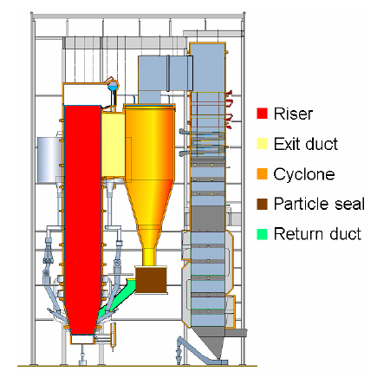
Circulating Fluidized Bed boiler (CFB)
Cyclone
Products
Seals
Fuel reactor
Fuel
Air reactor
Air

Slide 6
Circulating Fluidized Bed boiler (CFB)
Cyclone
Air reactor
Products
Fuel reactor
Seals
Fuel reactor
Fuel
Air reactor
Air

Slide 7
Why even bother with CLC?
CLC can reduce the energy penalty for CO₂ capture. In theory, there is no energy penalty compared to conventional combustion.
CLC can have close to 100% capture rate without extra costs or efforts.
Compared to post combustion, CLC has low CAPEX and small footprint. Everything can fit within the confined walls of a CFB boiler.
CLC does not require harmful chemicals. The oxygen carrier can be mineral ores (e.g. ilmenite) or slag products from mineral industries.
CLC has potential to reduce CO2 capture cost for several applications. For solid fuel combustion, most studies suggests ≈20 euro/ton_{CO2}.

Slide 8
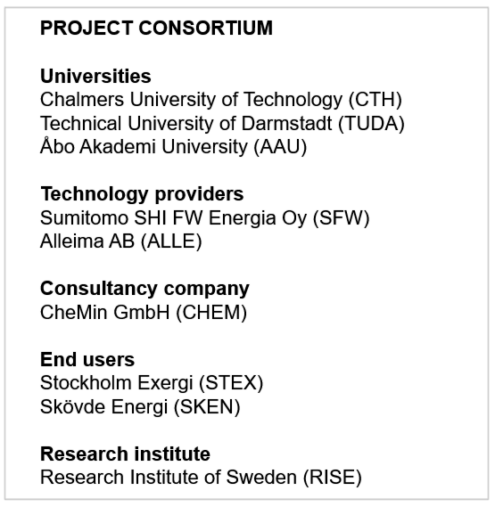
ACLOUD Project Pitch
In northern Europe, biomass and forestry waste are important domestic fuels.
In Europe as a whole, the use of waste-derived fuels seems destined to increase.
Difficult to convert, being inhomogeneous and rich in problematic ash species.
CLC could be an ideal conversion technology for difficult fuels. It provides inherent CO₂ capture, O₂ buffering to counter inhomogeneity and also separates heat-transfer surfaces from ash.

Slide 9
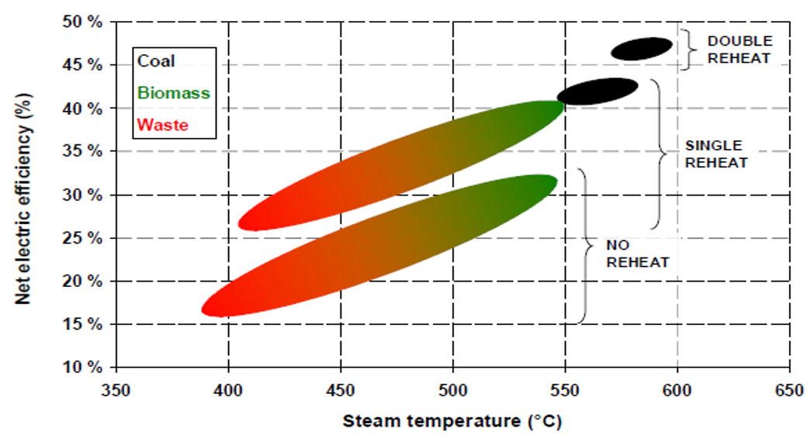
ACLOUD Project Pitch
No or minimal ash species
Atmosphere mainly N₂ and O₂
Temperature 900-1050°C
Air factor can be reduced
≈100% of heat generation
≈70% of total gas flow
No aggressive ash species here means that steam data can be increased, which means electric efficiency could be improved.
Air reactor
Minimal ash and deposits
Slightly reduced heat flow
Reduced gas radiation
Fuel reactor
Atmosphere mainly CO₂ and H₂O
Concentrated ash and impurities
Temperature 900-1050°C
≈Adiabatic reactor
≈30% of total gas flow
CFB, dual-CFB or other design?
Separate convection path?
Flue gas conditioning?

Slide 10
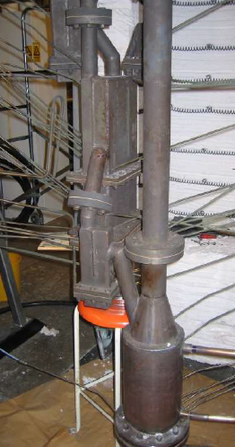
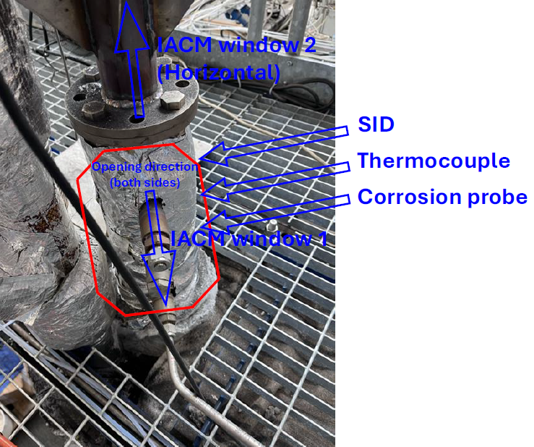
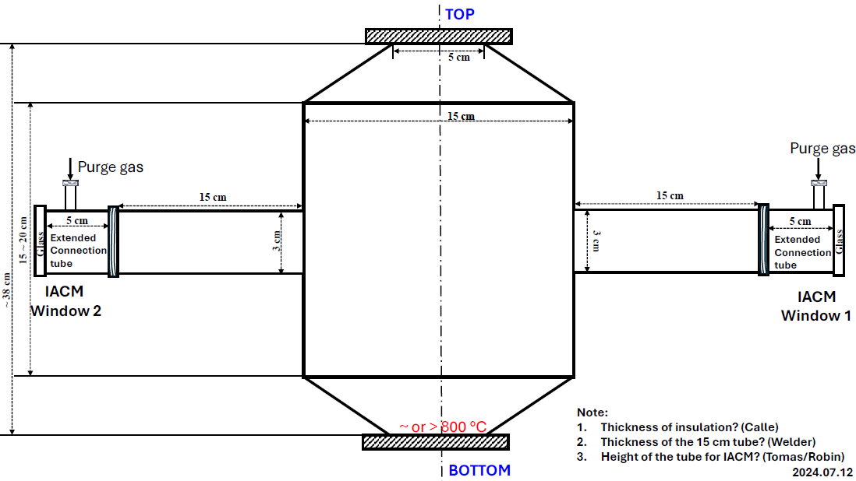
Project Activities
Demonstration at 1 MW scale with at least two relevant domestic fuels.
Work on pilot and lab scale related to fuel conversion pathways and ash chemistry. This includes development of new analysis and measurement techniques.
Corrosion and material studies, including applied on 1 MW and 10 kW pilot reactors.
Economic performance and environmental impact for key applications, such as e.g. waste-to-energy and combined heat-power.

Slide 11
Current status of CLC
Demonstrated in >>50 different pilot reactors for in total >>12000 h, using all sorts of fuels and a huge range of oxygen carriers. ≈80% of global experience is in Europe.
Demonstrated up to 5 MW_{th} scale, but most work is at 0.1-100 kW_{th}.
100% fuel conversion and 100% CO₂ capture feasible with gaseous fuels.
With coal and biomass >>90% fuel conversion and >>90% CO₂ capture is a realistic target. However, it is clear that dedicated flue gas conditioning and cleaning needs to be designed and developed.
The use and logistics of oxygen carriers have been demonstrated in >12 full-scale boilers in Sweden by Eon/Improbed, but without CO₂ capture.

Slide 12
Logotype

