Slide 1



Boost your impact:
Key Exploitable Results and main concepts
04/11/2024
Antonello Fiorucci

Slide 2
30 years of experience in «Knowledge To Market»
Notes:
2

Slide 3


30 years of experience in «Knowledge To Market»
bringing knowledge to market, helping researchers and entrepreneurs in exploiting the results of their project and commercialising their ideas
running European research-support services as Horizon Results Booster, IP Booster, ESIC, SSERR and CSSERR framework contracts (DG RTD)
training & coaching on how to communicate and pitch research results
engaging with a variety of stakeholders from Public agencies to early-stage investors across Europe
The DG RTD
main contractor to support funded projects with Exploitation and Dissemination services
www.horizonresultsbooster.eu
Framework contractors of DG RTD since 2012
1.800 research consortia supported in exploiting research results
More than 16.000 R&D projects participants coached and tutored
Notes:
3

Slide 4

Objectives
  Introducing impact and the elements that enable it
  Clarifying connections between results, outcomes, exploitation, dissemination, and communication
  Discussing and sharing experience
Notes:
Cosa si fara' insieme in quasti giorni

Slide 5
Objectives
  Introducing impact and the elements that enable it
  Clarifying connections between results, outcomes, exploitation, dissemination, and communication
  Discussing and sharing experience
Notes:
Cosa si fara' insieme in quasti giorni

Slide 6
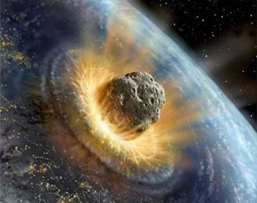
Keep it in mind

Slide 7

From research to impact:
the challenge of turning an innovation into benefits – The Experience of Horizon Europe
Innovation and impact are the keys to realizing the social, economic, and scientific value of public investment, transforming it into benefits for society.
This transformation is only possible through the use of results and is facilitated by exploitation and dissemination activities.

Slide 8

What do you think 'Impact’ is ?
8

Slide 9



Please download and install the Slido app on all computers you use
What you think 'Impact’ is?
ⓘ Start presenting to display the poll results on this slide.

Slide 10

Amazing Results
≠
Amazing Impact
ATTENTION!

Slide 11
ATTENTION!
Amazing Results
≠
Amazing Impact

Slide 12



Impact: long-term tangible benefit to society (including the environment), the economy, and science (enabled by the outcome)
Outcome: expected short-to-medium-term effect resulting from the use of the result through dissemination and exploitation activities (adoption of research result).
Impact - the result of a journey
KER: the result of research activity (problem solution) that can be used/adopted, either by the developer or by others.

Slide 13
Impact: long-term tangible benefit to society (including the environment), the economy, and science (enabled by the outcome)
Outcome: expected short-to-medium-term effect resulting from the use of the result through dissemination and exploitation activities (adoption of research result).
Impact - the result of a journey
KER: the result of research activity (problem solution) that can be used/adopted, either by the developer or by others.

Slide 14

Impact - the result of a journey
Impact: long-term tangible benefit to society (including the environment), the economy, and science (enabled by the outcome)
Outcome: expected short-to-medium-term effect resulting from the use of the result through dissemination and exploitation activities (adoption of research result).
KER: the result of research activity (problem solution) that can be used/adopted, either by the developer or by others.

Slide 15

Impact – the result of a journey
Impact: long-term tangible benefit to society (including the environment), the economy, and science (enabled by the outcome)
Outcome: expected short-to-medium-term effect resulting from the dissemination and exploitation activities (adoption of research result).
KER: the result of research activity (problem solution) that can be used/adopted, either by the developer or by others.

Slide 16
Impact – the result of a journey
Impact: long-term tangible benefit to society (including the environment), the economy, and science (enabled by the outcome)
Outcome: expected short-to-medium-term effect resulting from dissemination and exploitation activities (adoption of research result).
KER: the result of research activity (problem solution) that can be used/adopted, either by the developer or by others.

Slide 17
Impact – the result of a journey
Impact: long-term tangible benefit to society (including the environment), the economy, and science (enabled by the outcome)
Outcome: expected short-to-medium-term effect resulting from dissemination and exploitation activities (adoption of research result).
KER: the result of research activity (problem solution) that can be used/adopted, either by the developer or by others.

Slide 18
Impact – the result of a journey
Impact: long-term tangible benefit to society (including the environment), the economy, and science (enabled by the outcome)
Outcome: expected short-to-medium-term effect resulting from dissemination and exploitation activities (adoption of KER).
KER: the result of research activity (problem solution) that can be used/adopted, either by the developer or by others.

Slide 19




On what basis can we affirm the effective adoption of the solution?
What channels can I activate to facilitate the adoption of the proposed solution?
Questions to be answered…
Why does this specific research result better solve territory/community/adopter problems?
How do we measure impact – what indicators?
Notes:
Per soddisfare la citazione, dobbiamo iniziare a porci alcune domande introduttive, che rivelano:
Unique Value Proposition
Exploitation and dissemiantion
Outcomes e indicatori
Impatti e indicatori

Slide 20
What channels can I activate to facilitate the adoption of the proposed solution?
Questions to be answered…
On what basis can we affirm the effective adoption of the solution?
Why does this specific research result better solve territory/community/adopter problems?
How do we measure impact – what indicators?
Notes:
Per soddisfare la citazione, dobbiamo iniziare a porci alcune domande introduttive, che rivelano:
Unique Value Proposition
Exploitation and dissemiantion
Outcomes e indicatori
Impatti e indicatori

Slide 21
Questions to be answered…
What channels can I activate to facilitate the adoption of the proposed solution?
On what basis can we affirm the effective adoption of the solution?
Why does this specific research result better solve territory/community/adopter problems?
How do we measure impact – what indicators?
Notes:
Per soddisfare la citazione, dobbiamo iniziare a porci alcune domande introduttive, che rivelano:
Unique Value Proposition
Exploitation and dissemiantion
Outcomes e indicatori
Impatti e indicatori

Slide 22
Questions to be answered…
How do we measure impact – what indicators?
On what basis can we affirm the effective adoption of the solution?
What channels can I activate to facilitate the adoption of the proposed solution?
Why does this specific research result better solve territory/community/adopter problems?
Notes:
Per soddisfare la citazione, dobbiamo iniziare a porci alcune domande introduttive, che rivelano:
Unique Value Proposition
Exploitation and dissemiantion
Outcomes e indicatori
Impatti e indicatori

Slide 23
Questions to be answered…
How do we measure impact – what indicators?
On what basis can we affirm the effective adoption of the solution?
What channels can I activate to facilitate the adoption of the proposed solution?
Why does this specific research result better solve territory/community/adopter problems?
Notes:
Per soddisfare la citazione, dobbiamo iniziare a porci alcune domande introduttive, che rivelano:
Unique Value Proposition
Exploitation and dissemiantion
Outcomes e indicatori
Impatti e indicatori

Slide 24
Questions to be answered…
Why does this specific research result better solve territory/community/adopter problems?
How do we measure impact – what indicators?
On what basis can we affirm the effective adoption of the solution?
What channels can I activate to facilitate the adoption of the proposed solution?
Notes:
Per soddisfare la citazione, dobbiamo iniziare a porci alcune domande introduttive, che rivelano:
Unique Value Proposition
Exploitation and dissemiantion
Outcomes e indicatori
Impatti e indicatori

Slide 25
Questions?
25

Slide 26
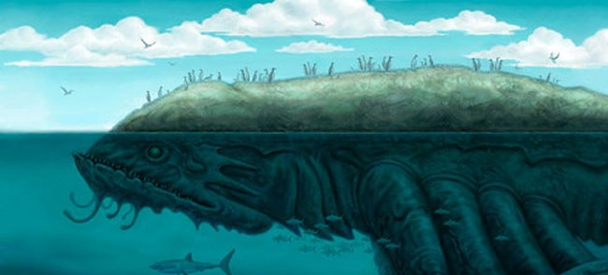
Is IMPACT a 'mythical' entity?
Notes:
26

