Slide 1
Energy System Modelling for Transition to a net-Zero 2050 for EU via REPowerEU
Flexibility assessment and expectations in European modeling and planning

Slide 2













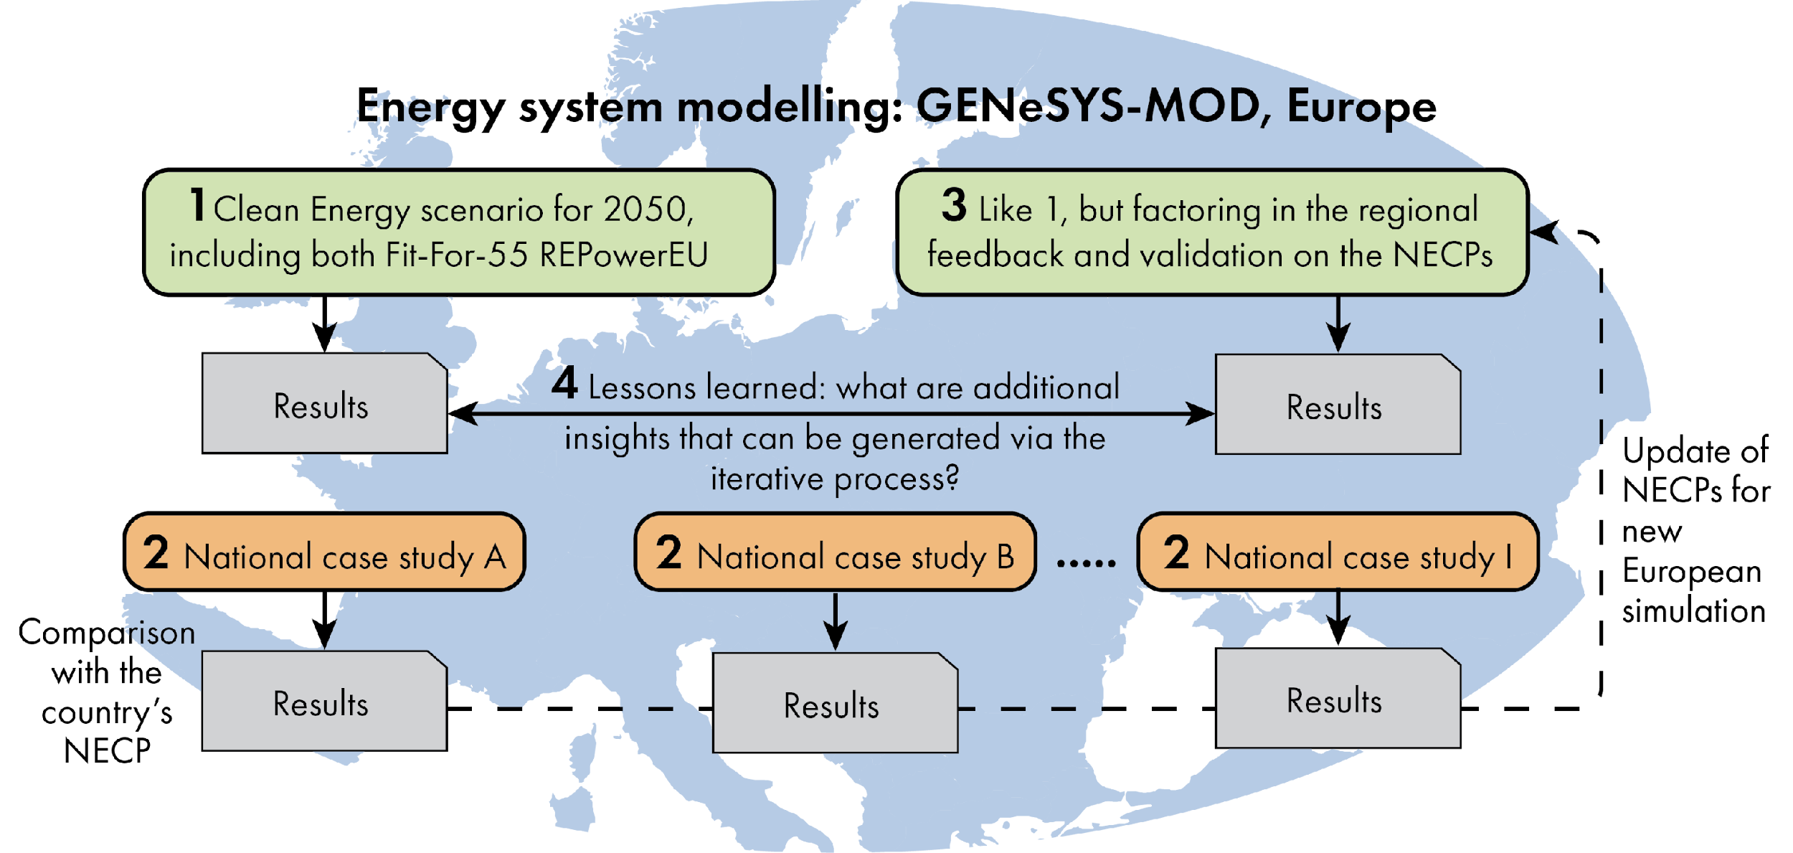








Type of project: Clean Energy Transition Partnership
Duration: 2023-2026 (36 months)

Slide 3
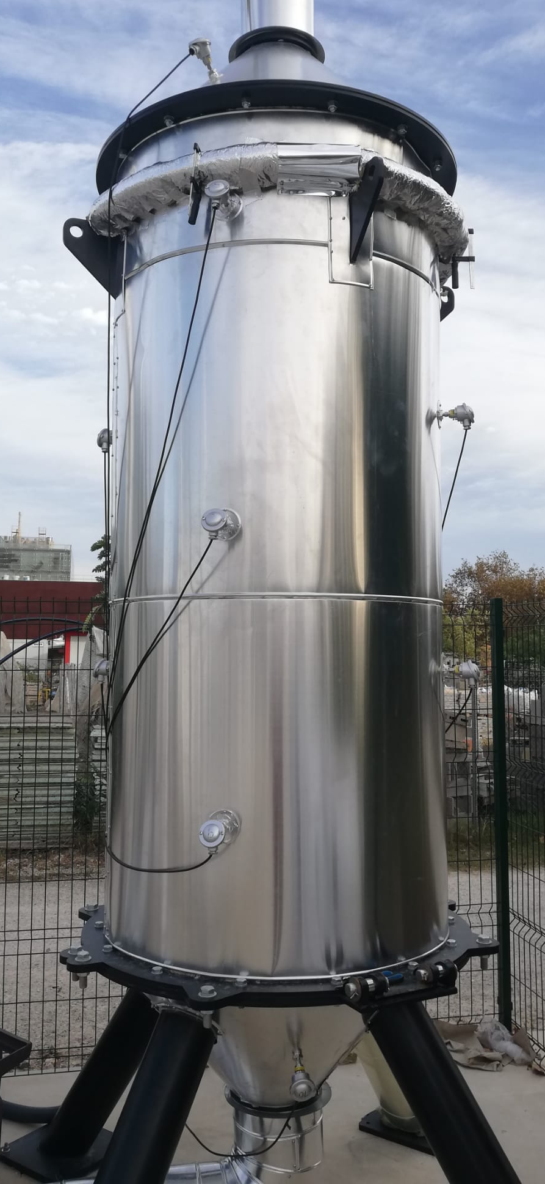
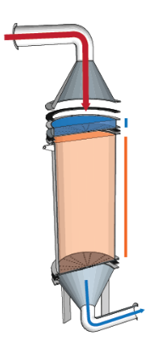
Power2heat and thermal storage
Characteristics
Peak power output
Total energy
LCOH
Modes of integration
Parallel
Complementary
Boosting
Modes of operation
Direct generation
Intermittent storage

Slide 4
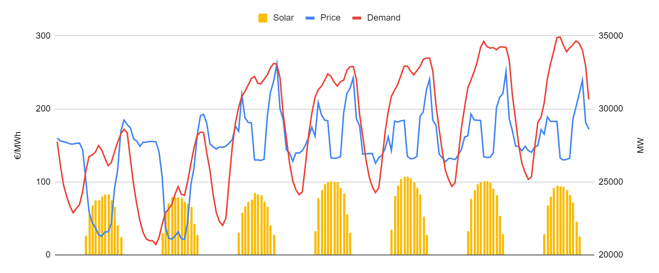
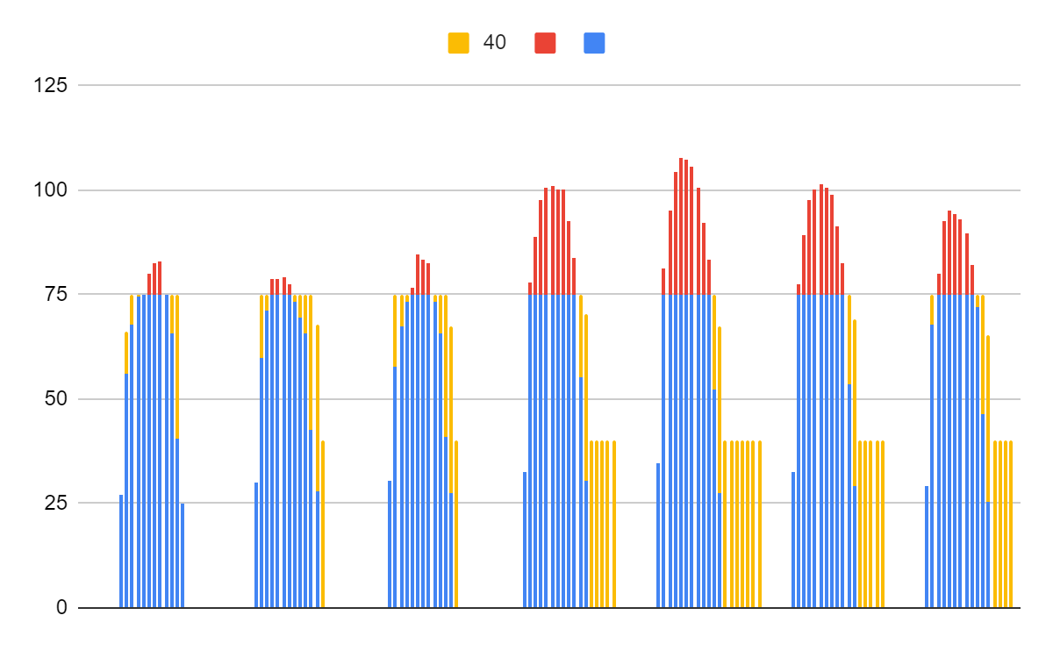
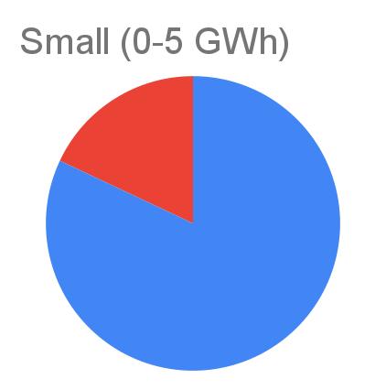
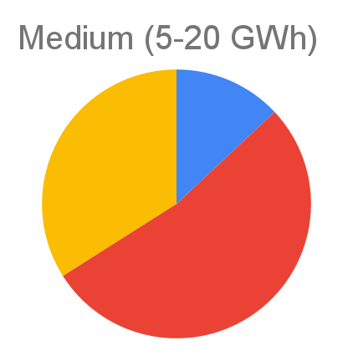
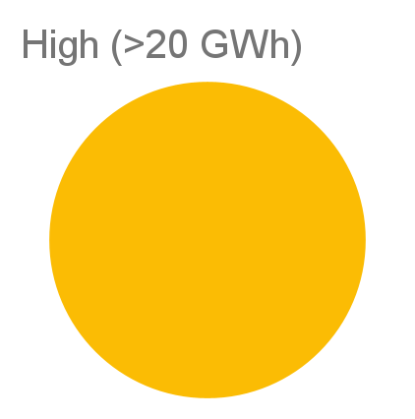
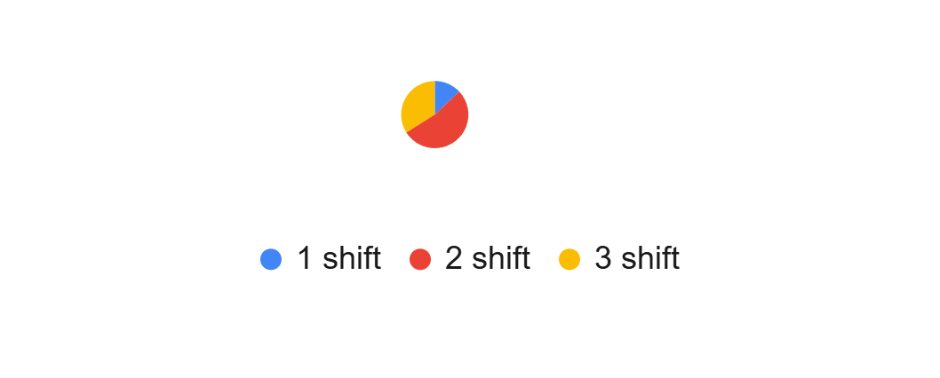
Simulations and flexibility

Slide 5
Expected challenges and results
Developing a general use application for the studied technology.
Capturing the advantages and disadvantages of specific configurations.
Implementation of a complex P2H and TES system in a generalist simulation.
Complete characterisation of a hybrid P2H+TES system.
Optimised strategy for operation of the proposed technology.
Simulation model capable of benefiting from the energy conversion of a P2H system and the load shifting of a TES system.

