Slide 1
Welcome to the CETPartnership Joint Call 2024 Q&A
We will start at 14:00 CEST!

Slide 2
Annual Joint Calls
Each TRI defines the scope of one or more Call Modules. Call Modules are the topics of each annual Joint Call.
All involved funding partners then decide which Call Modules they wish to participate in.
Applicants should be aware that NOT all funding partners participate in all call modules.
2

Slide 3
Call Modules Joint Call 2024
No. Title
CM2024-01 Energy data spaces and interoperability
CM2024-02 Energy system flexibility: renewables production, storage and system integration
CM2024-03A Advanced renewable energy (RE) technologies for power production (ROA)
CM2024-03B Advanced renewable energy (RE) technologies for power production (IOA)
CM2024-04 Carbon capture, utilisation and storage (CCUS)
CM2024-05 Hydrogen and renewable fuels
CM2024-06 Heating and cooling technologies
CM2024-07 Geothermal energy technologies
CM2024-08 Integrated regional energy systems
CM2024-09 Integrated industrial energy systems
CM2024-10 Clean energy integration in the built environment

Slide 4
General steps
Two-step procedure:
submission of a pre-proposal followed by an invitation to submit a full proposal
eligibility check according to both general and national/regional requirements
evaluation three experts per proposal
one ranking list per Call module (score at or above 10 and none of the criteria scoring below 3)
1

Slide 5
General steps
1
Pre-proposal
light form (including project description, consortium partners’ data, team members, project budget)
2
Full proposal
may not differ substantially from the pre-proposal
includes specific requirements for each evaluation criteria and info on IPR and data management and risk analysis
changes must be communicated to involved Project Partners and relevant Funding Partner(s)
avoid changes in the consortium composition, except if an ineligible partner is replaced.
1

Slide 6
General steps
Submission
Choose one Call Module per proposal
Project Coordinator invite Project Partners through the submission system
PIC and NACE codes needed for all organisations

Slide 7
Eligibility criteria
each project proposal must include at least three independent legal entities from at least three different countries participating in the CETPartnership Joint Call 2024, out of which at least two must be EU Member States or Horizon Europe Associated Countries
applicants must be eligible for funding according to their Funding Partner’s national/regional requirements
total effort of one Partner cannot exceed 60% of the total project efforts (person months)
total effort of Partners from one country/region cannot exceed 75% of the total project efforts (person months)

Slide 8
Consortia composition
Minimum 3 partners receiving funding, at least 2 must be from an EU or Horizon Europe associated country
public research organizations, universities and higher education institutions
"need-owner(s)" and relevant stakeholders (e.g. energy supply companies, DSOs, TSOs, system integrators, ICT companies, local/regional authorities, equipment and solutions providers, industrial companies, etc.)
one Project Coordinator
Partners eligible for direct funding by the Funding Partners participating in the CETPartnership Joint Call 2024
fully self-financed Partners from any country/region who brings their own secured budget – the self-financed Partner cannot be the Project Coordinator and does not count to fulfil the transnationality criteria
Notes:
The eligibility of the consoriumt must consist: Minimum 3 partners receiving funding, at least 2 must be from an EU or Horizon Europe associated country

Slide 9
Consortium building
…
…
Funding agency
of Country F
Funding agency
of Country A
Funding agency
of Country B
Funding agency
of Region C
Funding agency
of Country E
Funding agency
of Country D
Grant agreement
Reporting
Payments
Grant agreement
Reporting
Payments
Grant agreement
Reporting
Payments
Grant agreement
Reporting
Payments
Coordinator
(Country A)
Partner 2
(Country B)
Partner 3
(Country B)
Partner 4
(Region C)
Consortium Agreement

Slide 10
Call Calendar
General information about the call
Stage 1 Opening for pre-proposal submission | 19/09/2024
Stage 1 Closing | 21/11/2024, 14:00 CET
Stage 2 Opening for full-proposal submission | 29/01/2025
Stage 2 Closing | 02/04/2025, 14:00 CET
Funding decision communicated | July 2025
Project start (tentative) | September 2025
Application to national/regional Funding Agencies | Consult specific Funding Agency Annex.

Slide 11
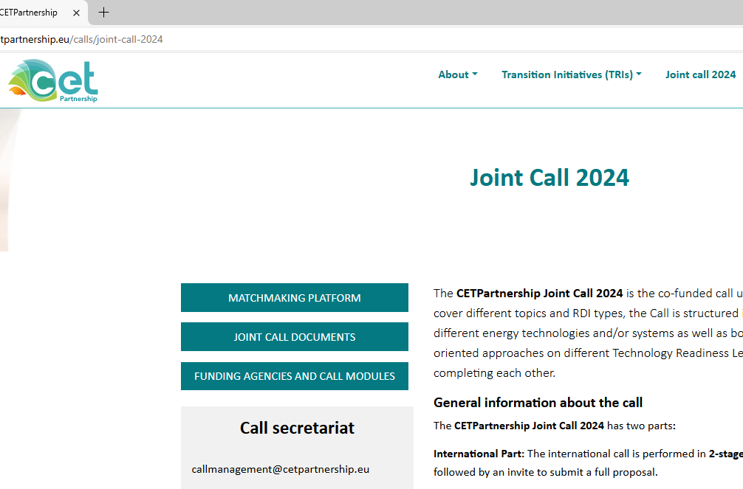
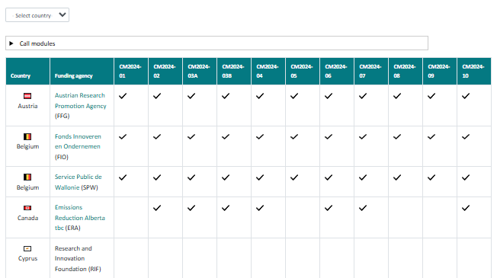
Find national contact points on the CETPartnership website

Slide 12
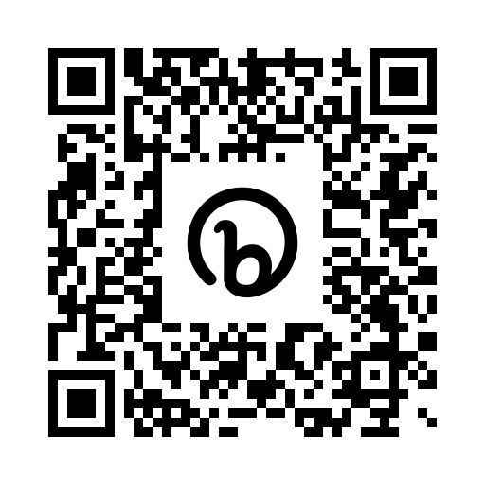
Stay tuned for call updates and other news!
https://cetpartnership.eu
https://www.linkedin.com/company/cetpartnership/
Home | Clean Energy Transition Partnership (b2match.com)
https://www.youtube.com/@cetpartnership

Slide 13
Any questions?
Your contact points for questions about…
Call application, submission, evaluation, calendar, etc.
Call modules and thematic topics
National requirements and national eligibility, project start & contractual matters
Finding project partners
Support Team/Matchmaking Co-Organisers
matchmaking@cetpartnership.eu or Organisers for Matchmaking | Clean Energy Transition Partnership
Your TRI Office
tri1@cetpartnership.eu tri2@cetpartnership.eu tri3@cetpartnership.eu tri4@cetpartnership.eu tri5@cetpartnership.eu tri6@cetpartnership.eu tri7@cetpartnership.eu
Call Management
callmanagement@cetpartnership.eu
Your national funding agency
https://cetpartnership.eu/ fundingagencies

Slide 14
Thank you!
callmanagement@cetpartnership.eu

