Slide 1
Value of thermal storage in industry to foster energy system flexibility
Peer2peer knowledge sharing workshop TRI1/TRI6
6 November, 2024, 9:00 – 12:00 CEST

Slide 2
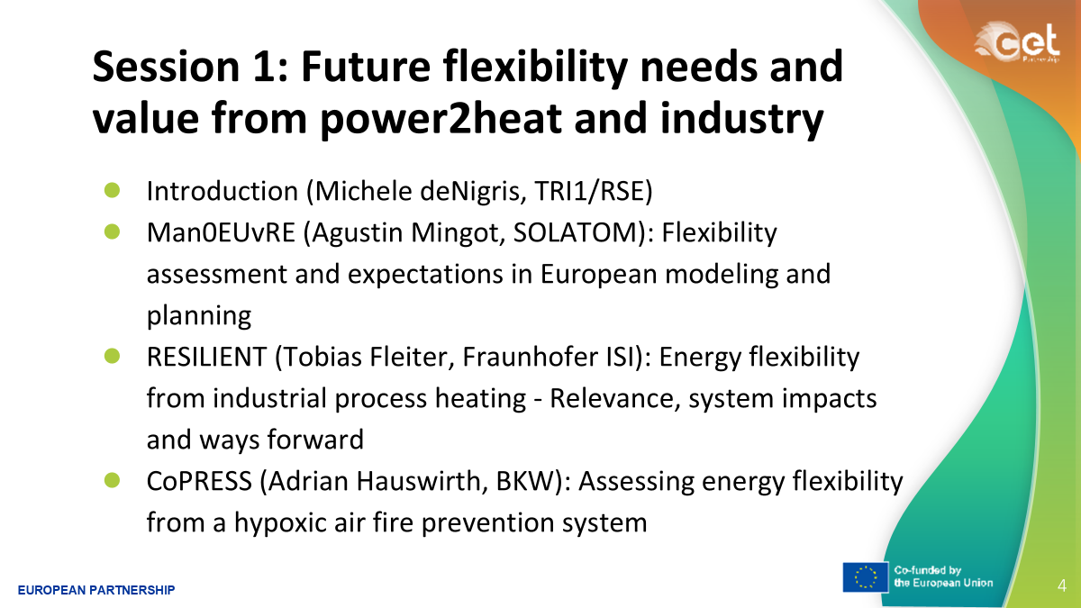
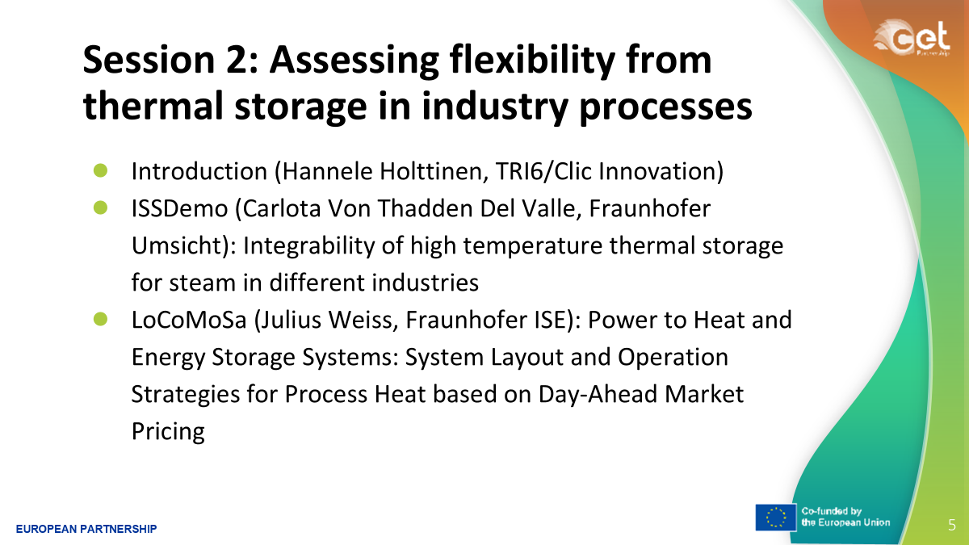
Agenda
Discussion Session

Slide 3
Introduction to Flexibility from industry
It does exist, already today to some extent
There is more need, and opportunities in future
  It will be crucial in wind and solar dominated power systems
What is the value, now and in future? How to assess it? How to model different industry process flexibilities in energy system models?

Slide 4
Summary - technical and feeding scoping of next calls
Potential of industrial flexibility should be assessed as realistically as possible in energy system models. In practice this is challenging, as
  different industrial processes cannot all be modelled in detail
  there are multitude of options with uncertain technology price reductions for future and with different options for flexibility
  We need to have flexibility also in modelling energy systems!
Value of flexibility is changing, depending on transition towards future (uncertain) scenarios we get different value. Challenge in quantifying the value.
  Industry thermal storage sizing will be optimized based on prices (value). This is a moving target/dynamic, and assumed prices will impact the flexibility in industry.
Hybrid operation during transition period, adding power 2 heat and thermal storage but keeping the gas - this could be used a learning process for industry
Time scales of flexibility, short term flexibility will have many other providers as well (a competition) – longer term flexibility of days/weeks has more needs in future that should be reflected in value (like a period of one week of high prices/scarcity of energy)

Slide 5
Summary - feeding future activities
Energy system modellers and industry thermal storage modellers –sharing project case results with other projects
  A follow up event once projects have results to share (2025/2026)
Regulatory framework, electricity market design
  Decarbonisation targets need to align with market operation practices for industry
Learning needed in individual companies
  For how to act in electricity markets, responsiveness for high/low prices gives the flexibility needed.
  For technical challenges in dimensioning and operating. Also for hybrid systems (like electric boilers in tandem with gas boilers affecting the efficiency)

Slide 6
Discussion session Q&A (1)
Technological learning curves and cost reductions of power 2 heat used in energy system models, what are the TRLs ?
  Most power 2heat technologies are commercial (TRL 9). Heat pumps >150C and direct heating to high temperature furnaces need further development (also higher temperature storage solutions presented)
Solutions in industry are complex and benefits are case-by-case and technology dependent – will this impact their feasibility in practice?
  Complexity at industry process level, also causing complexities when modelling at system level. However, once there is an economic business case, the complexity will not be an issue, companies will start proposing solutions for complexity when economic viability is seen.

Slide 7
Discussion session Q&A (2)
System integration for waste heat in wider scale? e.g. integration of industry and possible neighbouring local opportunities (heating and cooling)?
  District heating systems will have good opportunities for this, but outside those there are limited local possibilities for feasible waste heat utilisation. Incentives for the business cases are a must. It is difficult to rely (only) on waste heat from local providers as sometimes not there when needed.
Why companies are not already having e.g. electric boilers connected to their current fossil-based steam systems e.g. paper and pulp industry?
  One reason is that e.g. in Germany current grid tariffs do not give economic benefit - pricing favour base load solutions. This is not the case e.g. in the Nordic power market where electric boilers are increasingly being connected to the grid by industry (and electric utilities).

Slide 8
Thank you!
TRI 6 Integrated Industrial Energy Systems
TRI 1 Integrated Net-Zero Energy System

